Slide 1
AI Intro Basics #1
Neural Networks, Work Environment and a First Example
Roland Potthast, Stefanie Hollborn and Jan Keller

Slide 2
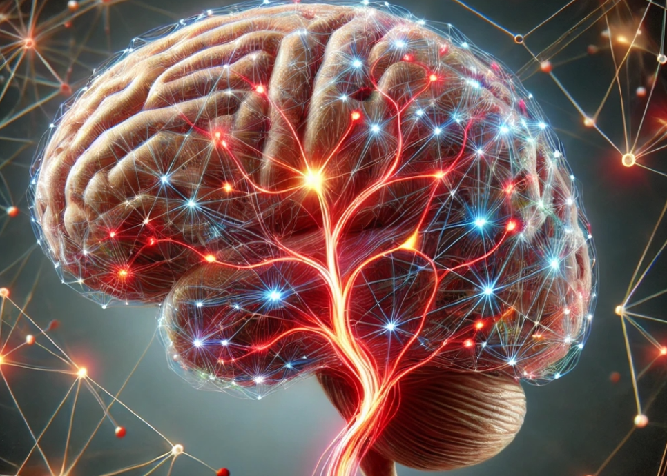
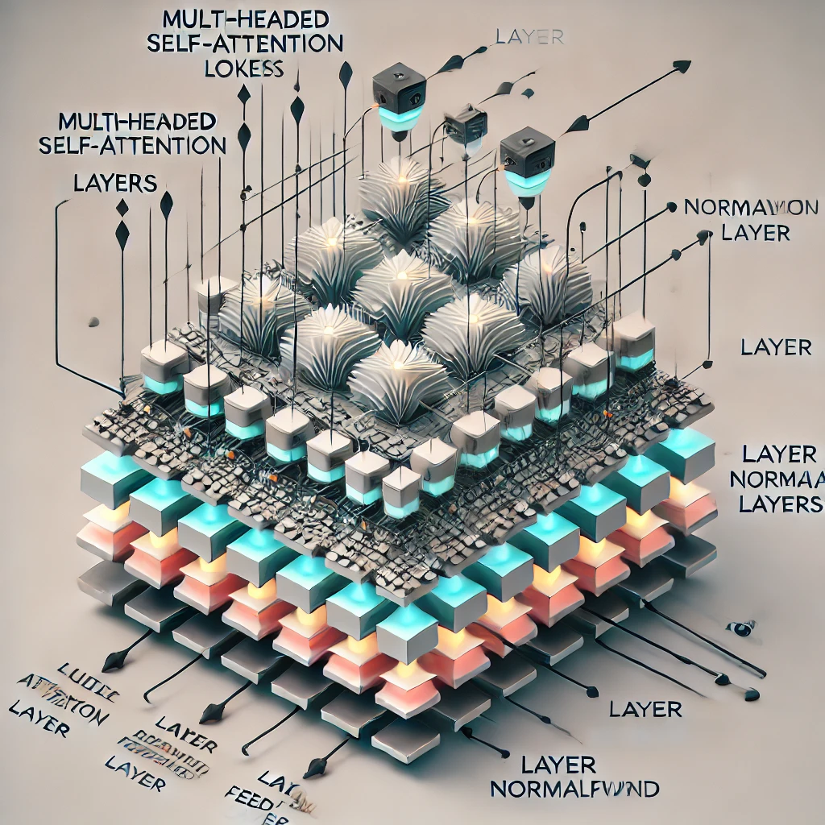
E-AI Basic Tutorials
Tutorial E-AI Basics 1: September 16, 2024, 11-12 CEST
Intro, Environment, First Example
1.1 Basic Ideas of AI Techniques (20') [SH]
1.2 Work Environment (20') [RP]
1.3 First Example for AI - hands-on (20') [JK]
Tutorial E-AI Basics 2: September 18, 2024, 13-14 CEST
Dynamics, Downscaling, Data Assimilation Examples
2.1 Dynamic Prediction by a Graph NN (20') [RP]
2.2 Downscaling via Encoder-Decoder (20') [SH]
2.3 AI for Data Assimilation (20') [JK]
Tutorial E-AI Basics 3: September 23, 2024, 11-12 CEST
LLM Use, Transformer Example, RAG
3.1 Intro to LLM Use and APIs (20') [RP]
3.2 Transformer for Language and Images (20') [JK]
3.3 LLM Retrieval Augmented Generation (RAG) (20') [SH]
1.1
AI generated Images, © Roland Potthast 2024

Slide 3
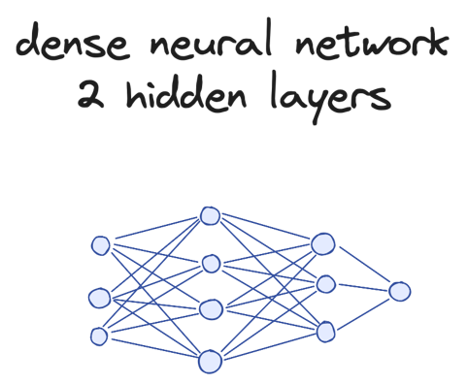
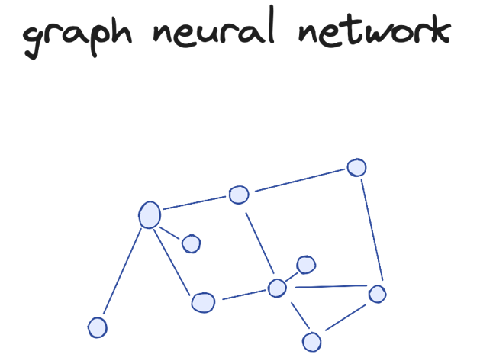
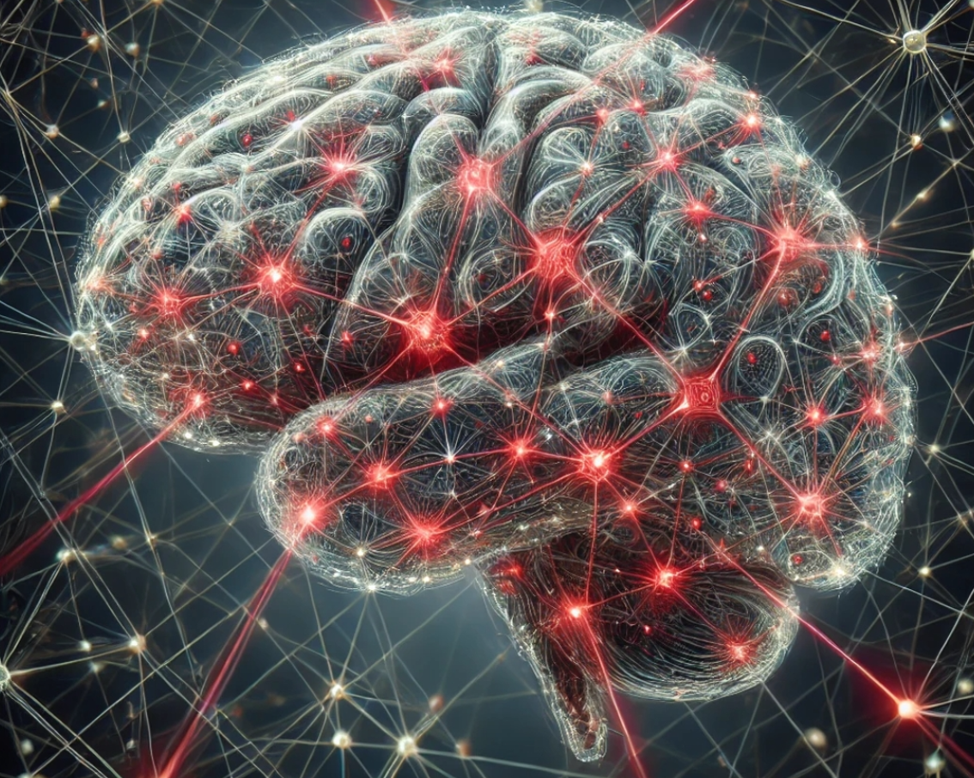
Neurons, Networks and Artificial Intelligence
1.1 Basic Ideas of AI Techniques
In a neural network, a signal is passed through layers of interconnected neurons, starting from the input layer, where data is provided. Each neuron processes the signal by applying weights and an activation function, then passes the output to the next layer, until it reaches the final output layer, where a prediction or decision is made.
Neurons are specialized cells in the brain that transmit information via electrical signals, forming neural networks that process tasks like learning and memory.
These networks inspire artificial neural networks in AI, enabling machines to recognize patterns, learn from data, and make decisions, simulating aspects of human intelligence.
Tools like PyTorch are widely used to build and train these neural networks, making it easier for developers to create sophisticated AI models.

Slide 4
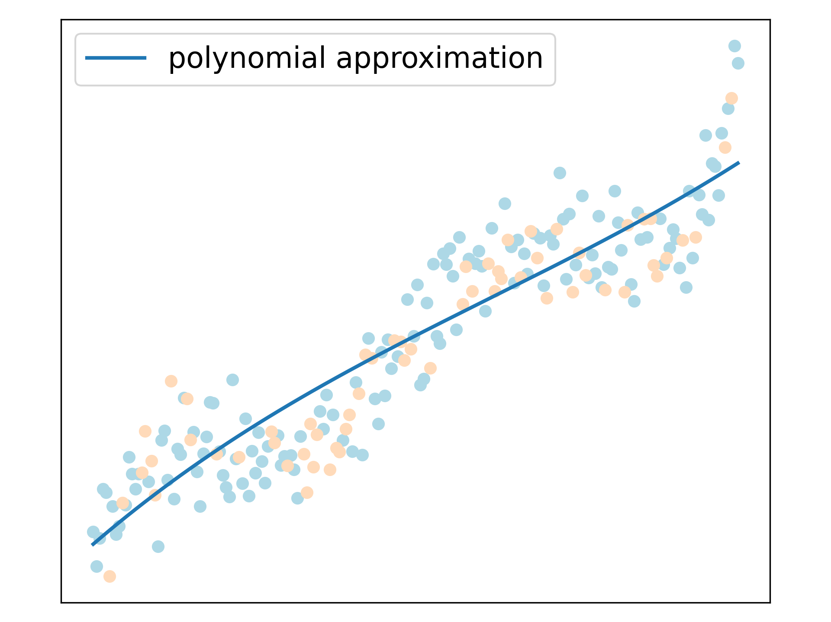
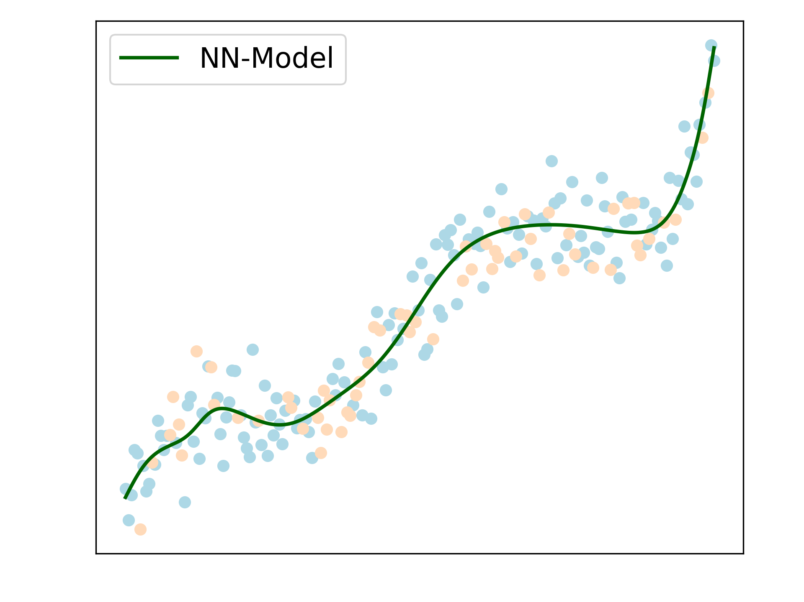
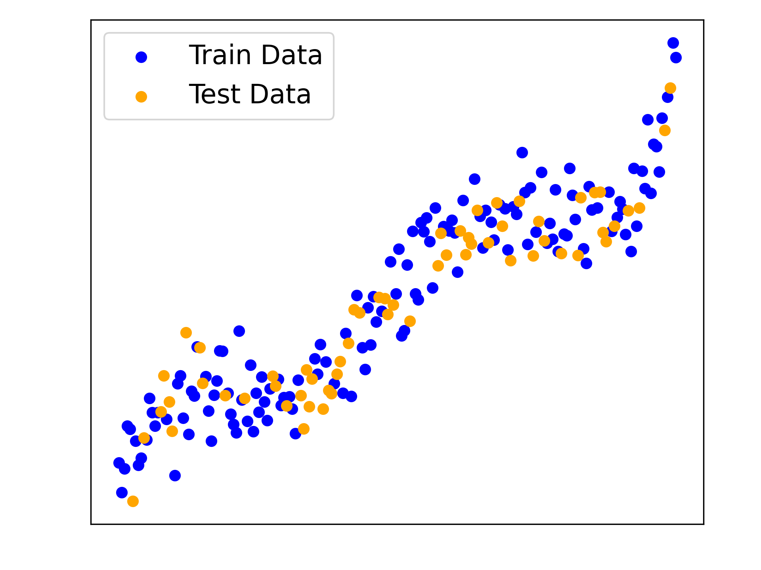
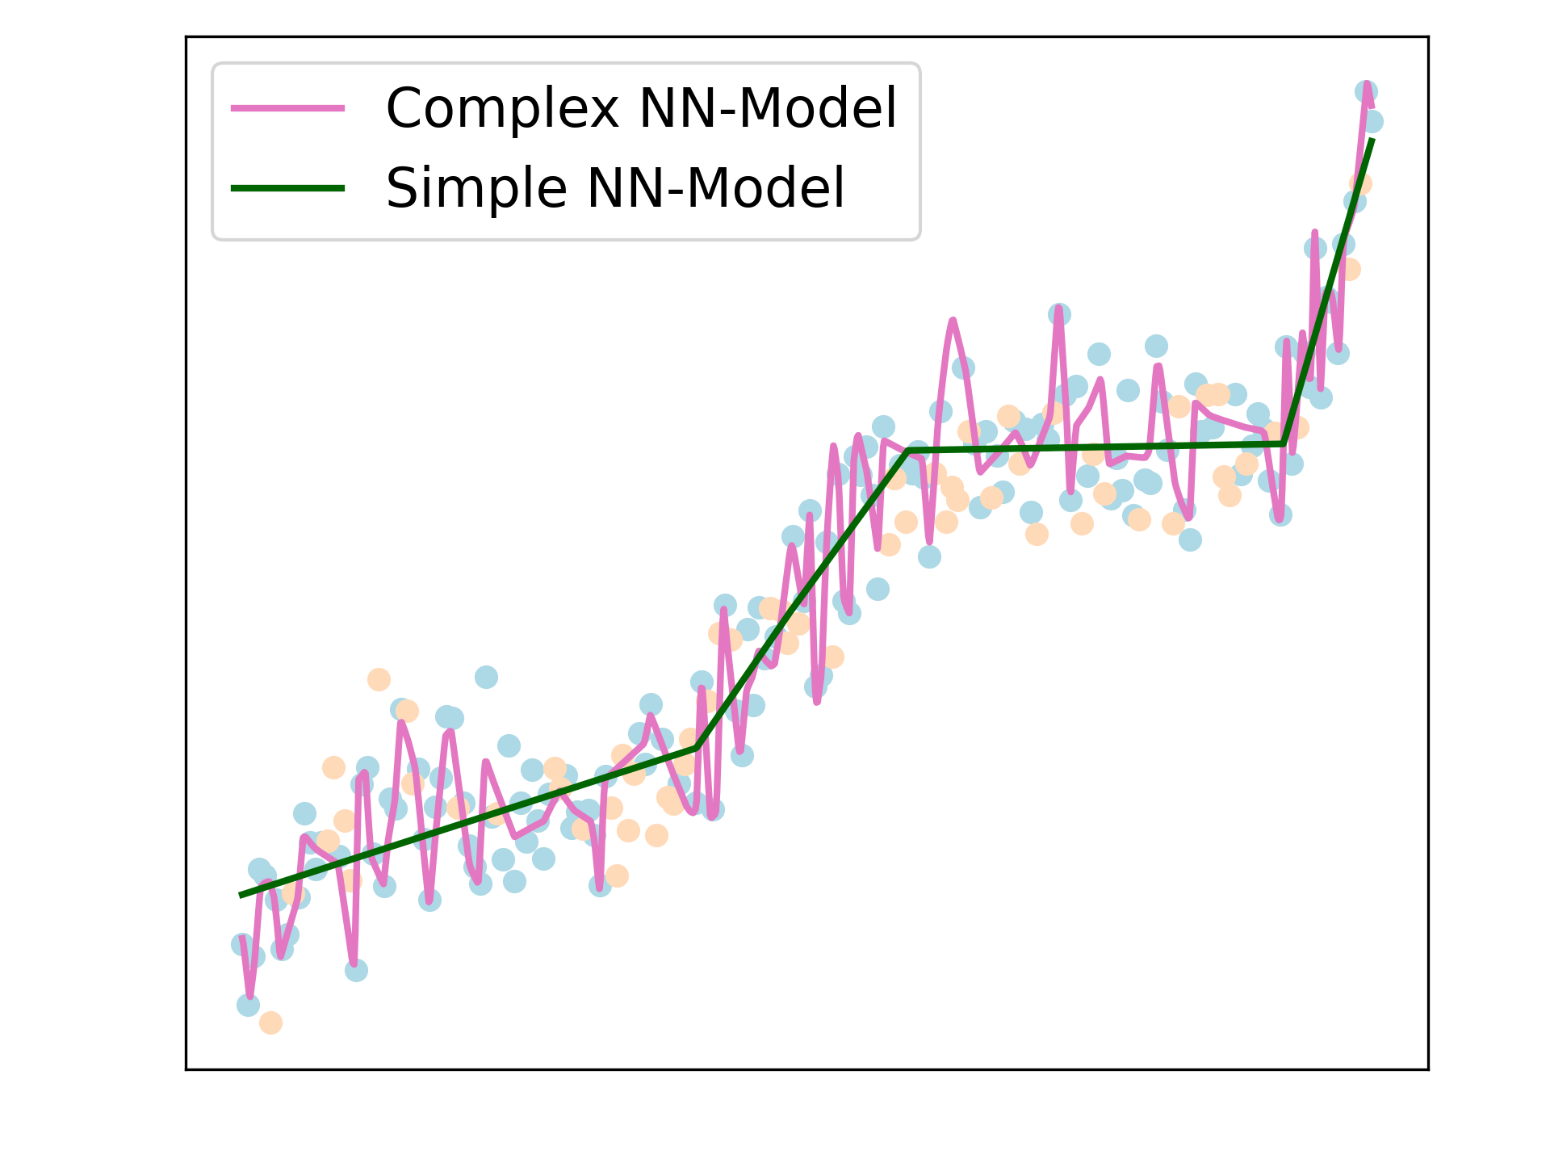
NN Approximating Complex Mappings
1.1 Basic Ideas of AI Techniques
Data and processes can be modeled using mathematical functions. To do this, the functions are trained on a set of training data and evaluated on a separate set of test data. During the training process, the parameters of the functions are adjusted to best fit and describe the data.
The quality of the approximation depends on the quality of the training data, the chosen architecture, and the training process.
Data can be approximated using various types of functions and methods, such as polynomials or trigonometric functions.
Neural networks, however, offer a highly flexible and powerful class of ansatz functions for tackling complex approximation tasks.

Slide 5
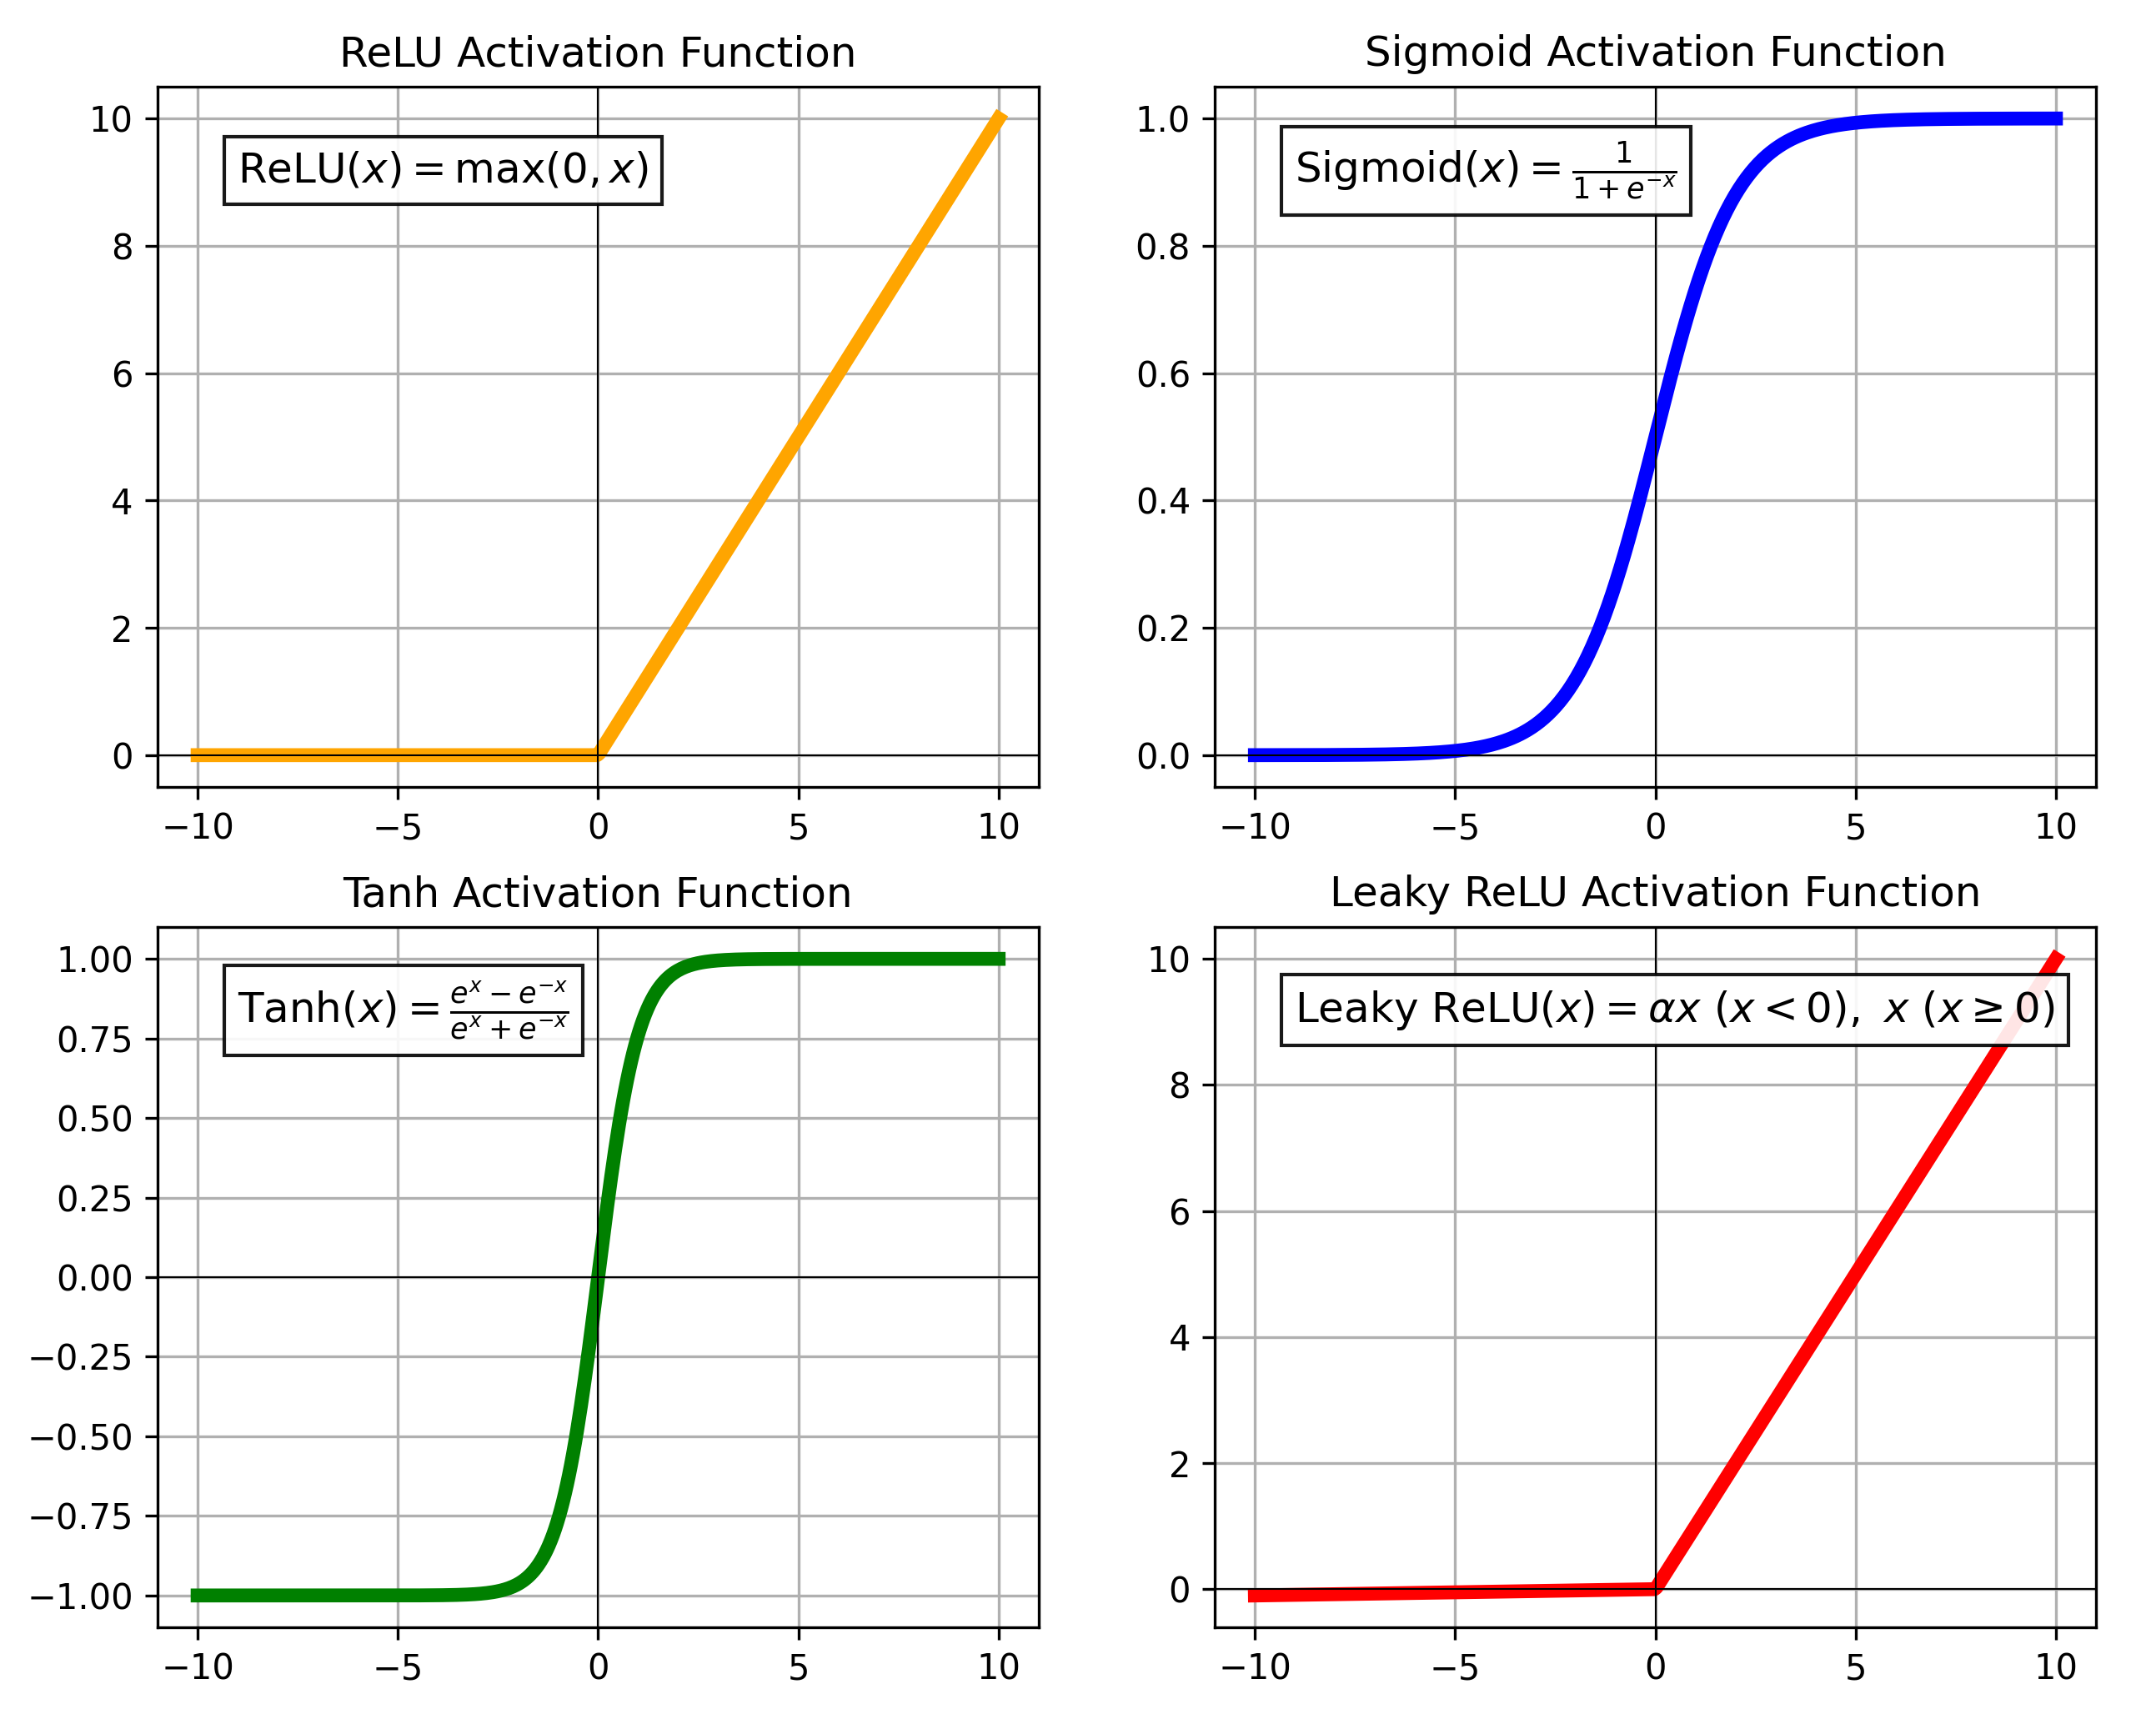
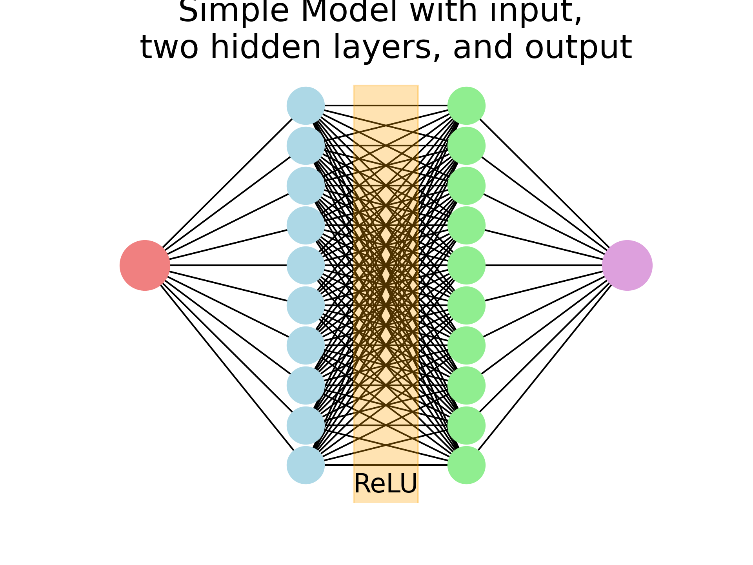
Feed Forward Networks
1.1 Basic Ideas of AI Techniques
How it works
In broad terms, neural network architecture refers to how neurons (the basic units) are arranged and connected in layers to process data. At its core, a neural network consists of three main types of layers.
Input Layer:
This is where data is fed into the network. Each node in the input layer represents a feature or dimension of the input data (e.g., pixel values for an image or words in a sentence).
Hidden Layers:
These layers sit between the input and output layers and are responsible for learning patterns in the data. Each neuron in a hidden layer receives inputs from neurons in the previous layer, processes this information by applying weights and biases, and then passes the results through an activation function introducing nonlinearity. Networks can have multiple hidden layers, which allow them to learn more complex patterns.
Simple NN-Model with input, two hidden layers, and output
Output Layer:
This is the final layer where predictions or classifications are made. The number of neurons in this layer typically corresponds to the number of classes in a classification task or the size of the predicted output in a regression task.

Slide 6
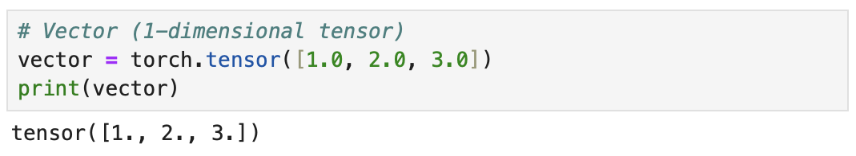
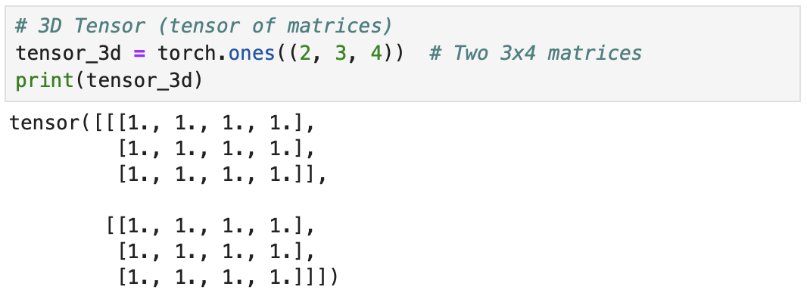
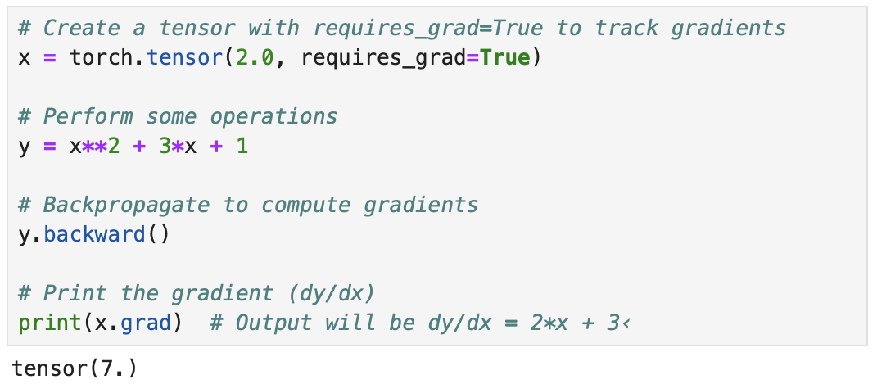
How do Networks look like?
1.1 Basic Ideas of AI Techniques
Tensors are the fundamental data structures used in machine learning frameworks like PyTorch and TensorFlow, serving as multi-dimensional arrays that can represent data of various dimensions.
They are essentially generalized matrices that can hold numbers in any number of dimensions, enabling the representation of everything from simple scalars (0D), vectors (1D), and matrices (2D) to more complex, high-dimensional structures (e.g., 3D or 4D tensors).
Basic Tensor Structure:
Scalars (0D): A single number, like a basic data point (e.g., 3 or 5.5).
Vectors (1D): A one-dimensional array of numbers (e.g., a list like [1,2,3][1, 2, 3][1,2,3]).
Matrices (2D): A two-dimensional grid of numbers (e.g., a table or grid of values, like a spreadsheet).
Higher-Dimensional Tensors (3D and above): Tensors can have more than two dimensions, representing more complex structures like sequences of matrices or batches of images (e.g., 4D tensors can represent a batch of colored images, where dimensions might be: batch size, height, width, and color channels).

Slide 7
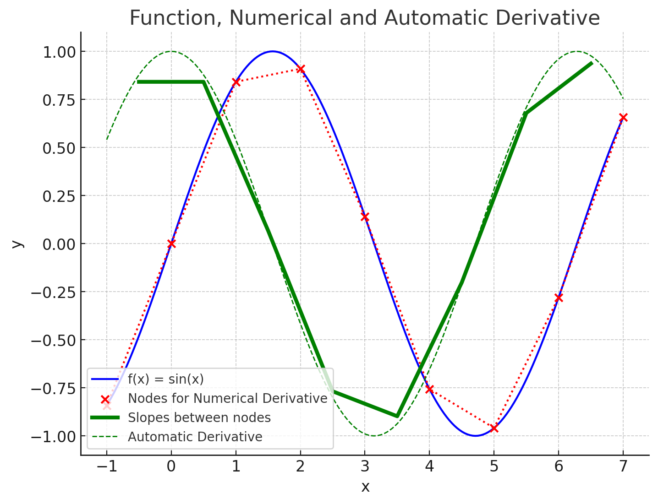
Tools at your Fingertips
1.1 Basic Ideas of AI Techniques
Efficient GPU Utilization:
PyTorch provides seamless support for moving tensors to GPUs for faster computation. Tensors can be moved between the CPU and GPU using .to(device) methods, making large-scale computations and deep learning models more efficient.
In PyTorch, tensors are the core structure used for building and training neural networks. PyTorch’s flexibility with tensors allows developers to easily handle different types of data. Tensors in PyTorch are optimized to run efficiently on both CPUs and GPUs, enabling fast computation of neural networks.
Automatic Differentiation:
PyTorch supports automatic differentiation using its autograd feature. This means that during neural network training, PyTorch computes the gradients of tensors automatically with respect to a loss function, which helps in optimizing the model.
Broadcasting:
PyTorch supports broadcasting, which allows it to handle tensors of different shapes in operations like addition or multiplication by automatically expanding them to a compatible shape.
Multi-Dimensional Tensors:
In more advanced scenarios, tensors in PyTorch can represent complex data types like batches of images (4D tensors with dimensions: batch size, number of channels, height, and width) or even sequences of data in time (e.g., 3D tensors for recurrent networks with dimensions representing batch size, sequence length, and feature size).

Slide 8
Training to fit – do not overfit!
1.1 Basic Ideas of AI Techniques
Training data need to be diverse, representative and sufficiently large to capture the underlying patterns of the task.
During training, overfitting can occur if the model becomes to specialized in the training data, learning even the noise and the irrelevant patterns. Non-convergence in neural network training occurs when the model fails to learn from the data, meaning that the loss function does not decrease efficiently.
Training is the process of teaching a model to make accurate predictions by adjusting its parameters. Data is processed in smaller groups called batches, with the number of samples in each batch determined by the batch size. A complete pass through the whole training dataset is called an epoch.
During a forward pass, the model processes input data through its layers to generate and output. The difference between the predicted outcome and the actual result is measured using a loss function, which quantifies the error. The goal is to minimize this error over time.
The reduce the error, the model uses backpropagation, where the loss is propagated backward through the network to update the model’s weights. This process is repeated typically after each batch and repeated over many epochs.
The fully trained model can perform inference, making predictions on new, unseen data.

Slide 9
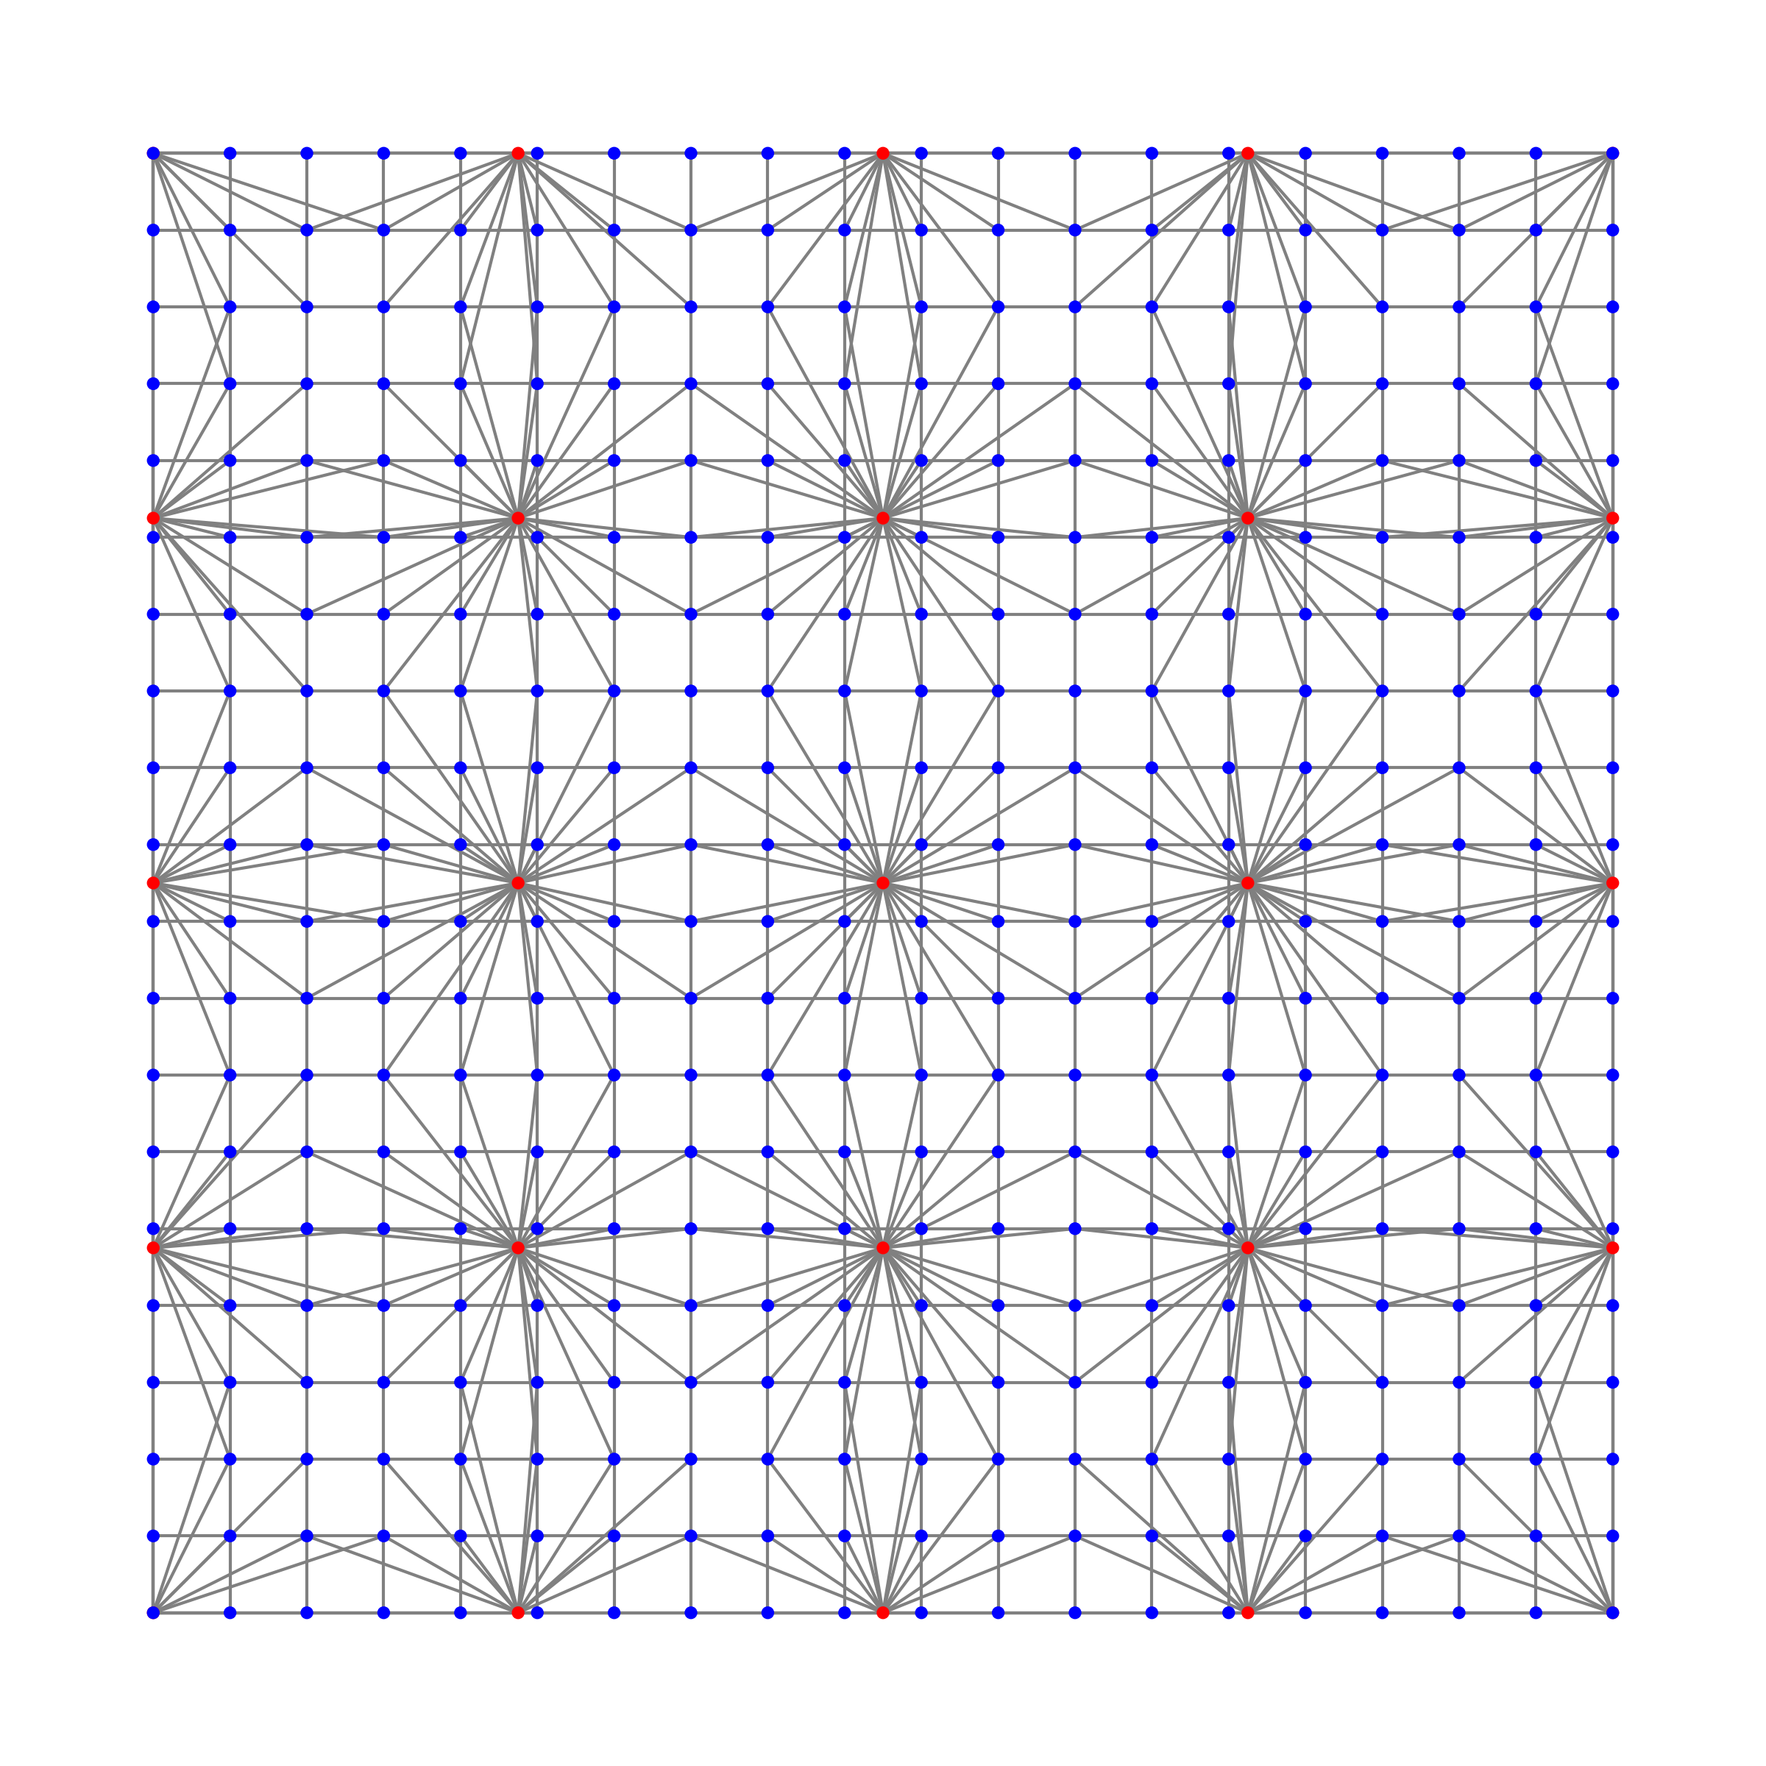
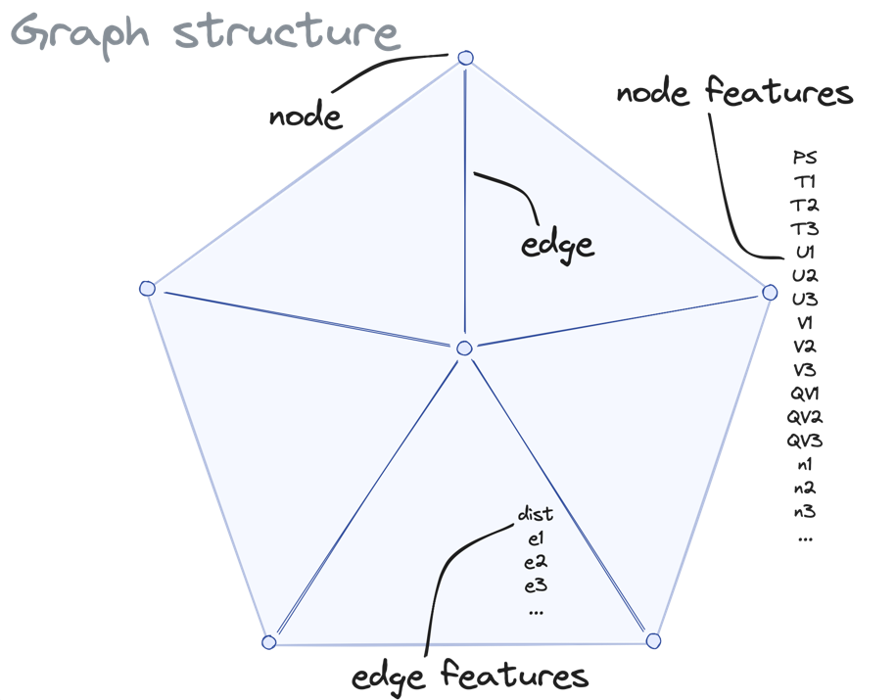
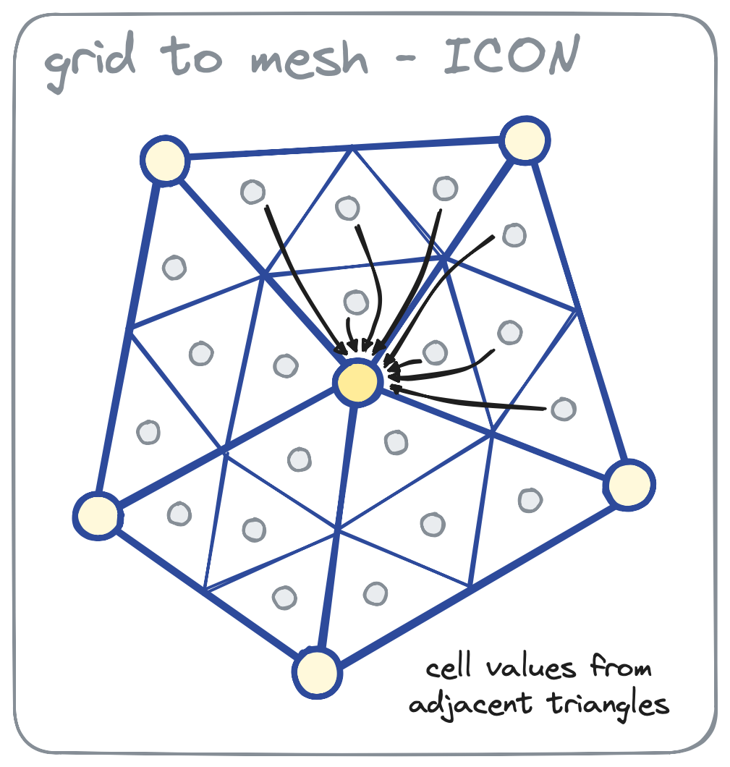
Graph Neural Networks – Basic Idea 1/2
1.1 Basic Ideas of AI Techniques
Graph Neural Networks (GNNs) are a type of neural network designed to work on graph-structured data, where entities (nodes) are connected by relationships (edges). Unlike traditional neural networks, GNNs use graph structures to capture both the features of individual nodes and their connectivity within the graph.
By passing information between nodes through edges, GNNs allow for the modelling of complex relationships, making them effective for tasks like social network analysis, molecular modelling, and recommendation systems.
GNNs leverage techniques like message passing to aggregate and update node representations based on their neighbours.
To construct a graph, start by defining its nodes (vertices), which represent individual entities in your data. Then, establish edges between these nodes, representing the relationships or connections between the entities, forming the structure of the graph.

Slide 10
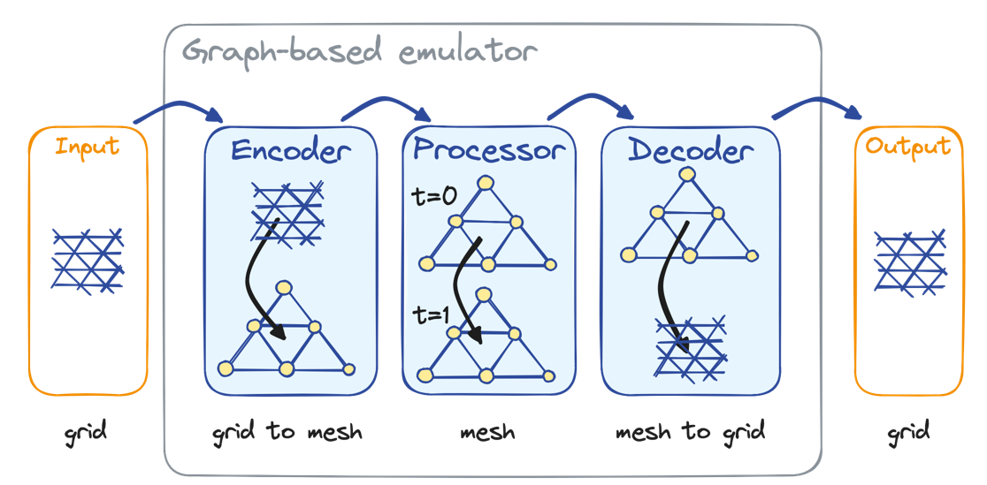
Graph Neural Networks – Basic Idea 2/2
1.1 Basic Ideas of AI Techniques
In graph-based models using an encoder, processor, and decoder, the encoder transforms raw graph data, such as node features and edge connections, into an initial set of embeddings that represent the graph's structure and features.
The processor (often a Graph Neural Network) then iteratively updates these embeddings by passing messages between connected nodes, refining their representations based on neighbouring nodes and edges.
After processing, the decoder takes the updated embeddings and generates a final output, which could be a prediction about node classification, edge prediction, or a graph-level task. This framework is widely used in applications like molecular property prediction, knowledge graphs, and social network analysis.
To learn more about Graph Neural Networks (GNNs), it’s helpful to start by understanding how message passing works between nodes, where information is shared across connected nodes in the graph.
You should also explore basic GNN applications, like node classification and link prediction, which are common tasks in social networks and recommendation systems.

Slide 11
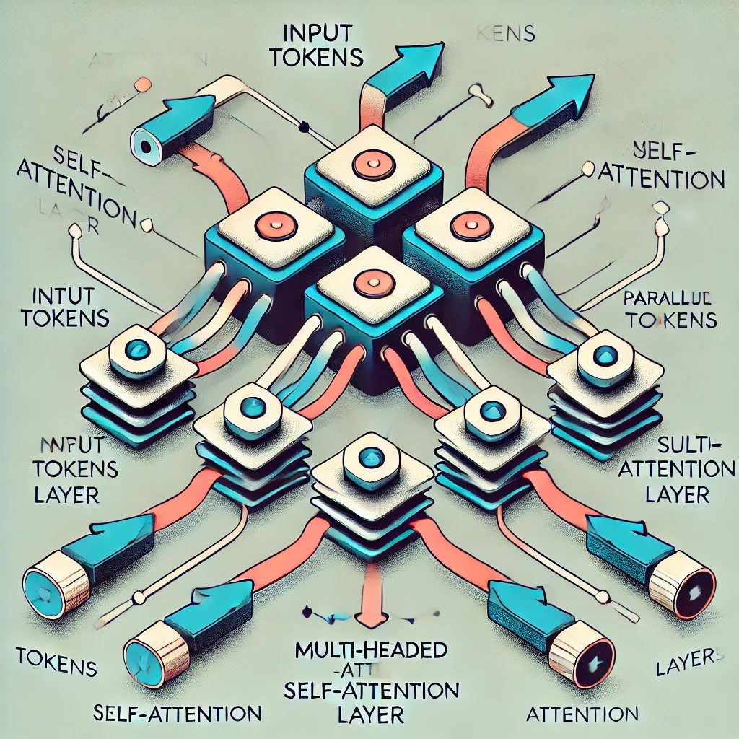
Transformer Networks 1/2
1.1 Basic Ideas of AI Techniques
Q (Query): Represents the current token (word or part of the input) that is being processed.
K (Key): Vector used to compare against all other tokens to find relevance to the current token.
V (Value): Contains information from the tokens that are deemed important or relevant.
Transformer neural networks are a type of deep learning model that perform extremely well at processing sequential data, such as language, by using self-attention mechanisms. Thereby, the model decides how much focus to place on different words in a sentence when making predictions or understanding the context.
Unlike traditional models, transformers can handle input data in parallel rather than sequentially, making them more efficient and scalable and improving performance in tasks like natural language processing (NLP), machine translation, and text summarization.
Transformers have become the foundation for many state-of-the-art models, including BERT and GPT, which are widely used in modern AI applications.
Here is a simple example sentence with token representations for a Transformer neural network:
Sentence: "The cat sat on the mat."
Token representation:
Token 1: "The"
Token 2: "cat"
Token 3: "sat"
Token 4: "on"
Token 5: "the"
Token 6: "mat"
Each of these tokens will be transformed into embeddings (the word’s numeric representations) that will interact with each other through the Query (Q), Key (K), and Value (V) mechanisms during the self-attention process to determine relationships between words, like how "cat" and "sat" are closely related in this sentence.
Each input token interacts with the others based on these Q, K, and V values
Notes:
The key in the transformer model is not simply a number but rather a vector—a list of numbers—that represents a word in a multi-dimensional space. This vector contains information about the meaning or characteristics of the word, which is then used to measure how relevant the word is to other words in the sentence during the self-attention mechanism.
Let’s break it down further:
Vectors: In the transformer model, each word in a sentence is represented by a vector (a series of numbers). The vector for each word is produced by multiplying the word's embedding (its numeric representation) by a weight matrix specific to the key, query, or value.
Key as a Vector:
For each word, the key vector is created through a learned transformation (a matrix multiplication). This vector acts as a descriptor of the word.
The key vector is used to determine how much attention other words should pay to it. It's a way to represent the word's role or significance in the context of the sentence.
Similarity between Query and Key:
The self-attention mechanism compares the query vector of one word with the key vectors of all the other words in the sentence.
This comparison is done through a dot product (a mathematical operation that results in a single number), which measures how similar or relevant the words are to each other.
The result of this comparison is used to weigh how much attention the model should place on each word.
Example for "The cat sat on the mat":
When the model processes the word "sat" as a query, it compares the query vector for "sat" to the key vectors of all the other words ("the," "cat," "on," etc.). These key vectors represent how each word can contribute to understanding "sat."
If the key vector of "cat" has high similarity to the query vector of "sat" (based on their dot product), the model concludes that "cat" is important for understanding "sat" and gives it more attention.
So, to summarize:
Key is a vector (not just a single number) representing the properties of a word.
The key is compared with the query to figure out which words should be focused on more heavily in a sentence.
Let me know if you need more clarification on this!

Slide 12
Recommendations Basics 1/3
1.1 Basic Ideas of AI Techniques
Understand the Basics:
Begin by studying the fundamental concepts such as how neurons function, how layers are structured, and what activation functions do.
Grasping these core ideas will make more complex topics easier to understand later.
Take Interactive Courses:
Online learning platforms offer great tutorials that include both theory and practical coding exercises.
Look for courses that offer a mix of hands-on practice with programming and theoretical lessons on how neural networks operate.
Practice with Frameworks:
Using libraries like PyTorch or TensorFlow allows you to build and train neural networks.
Working through coding examples will help solidify your understanding of network architectures and training processes.

Slide 13
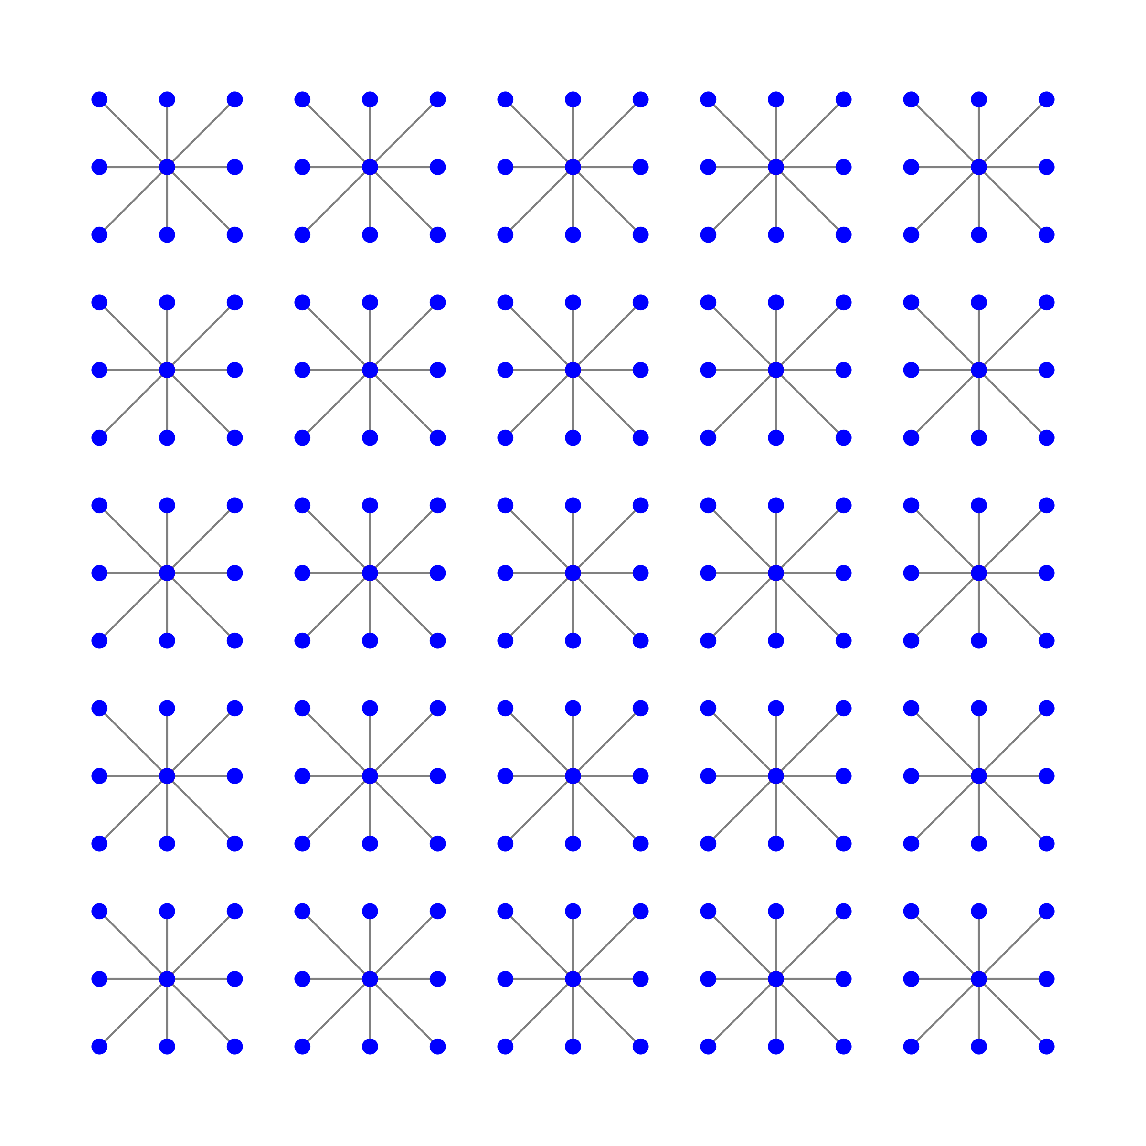
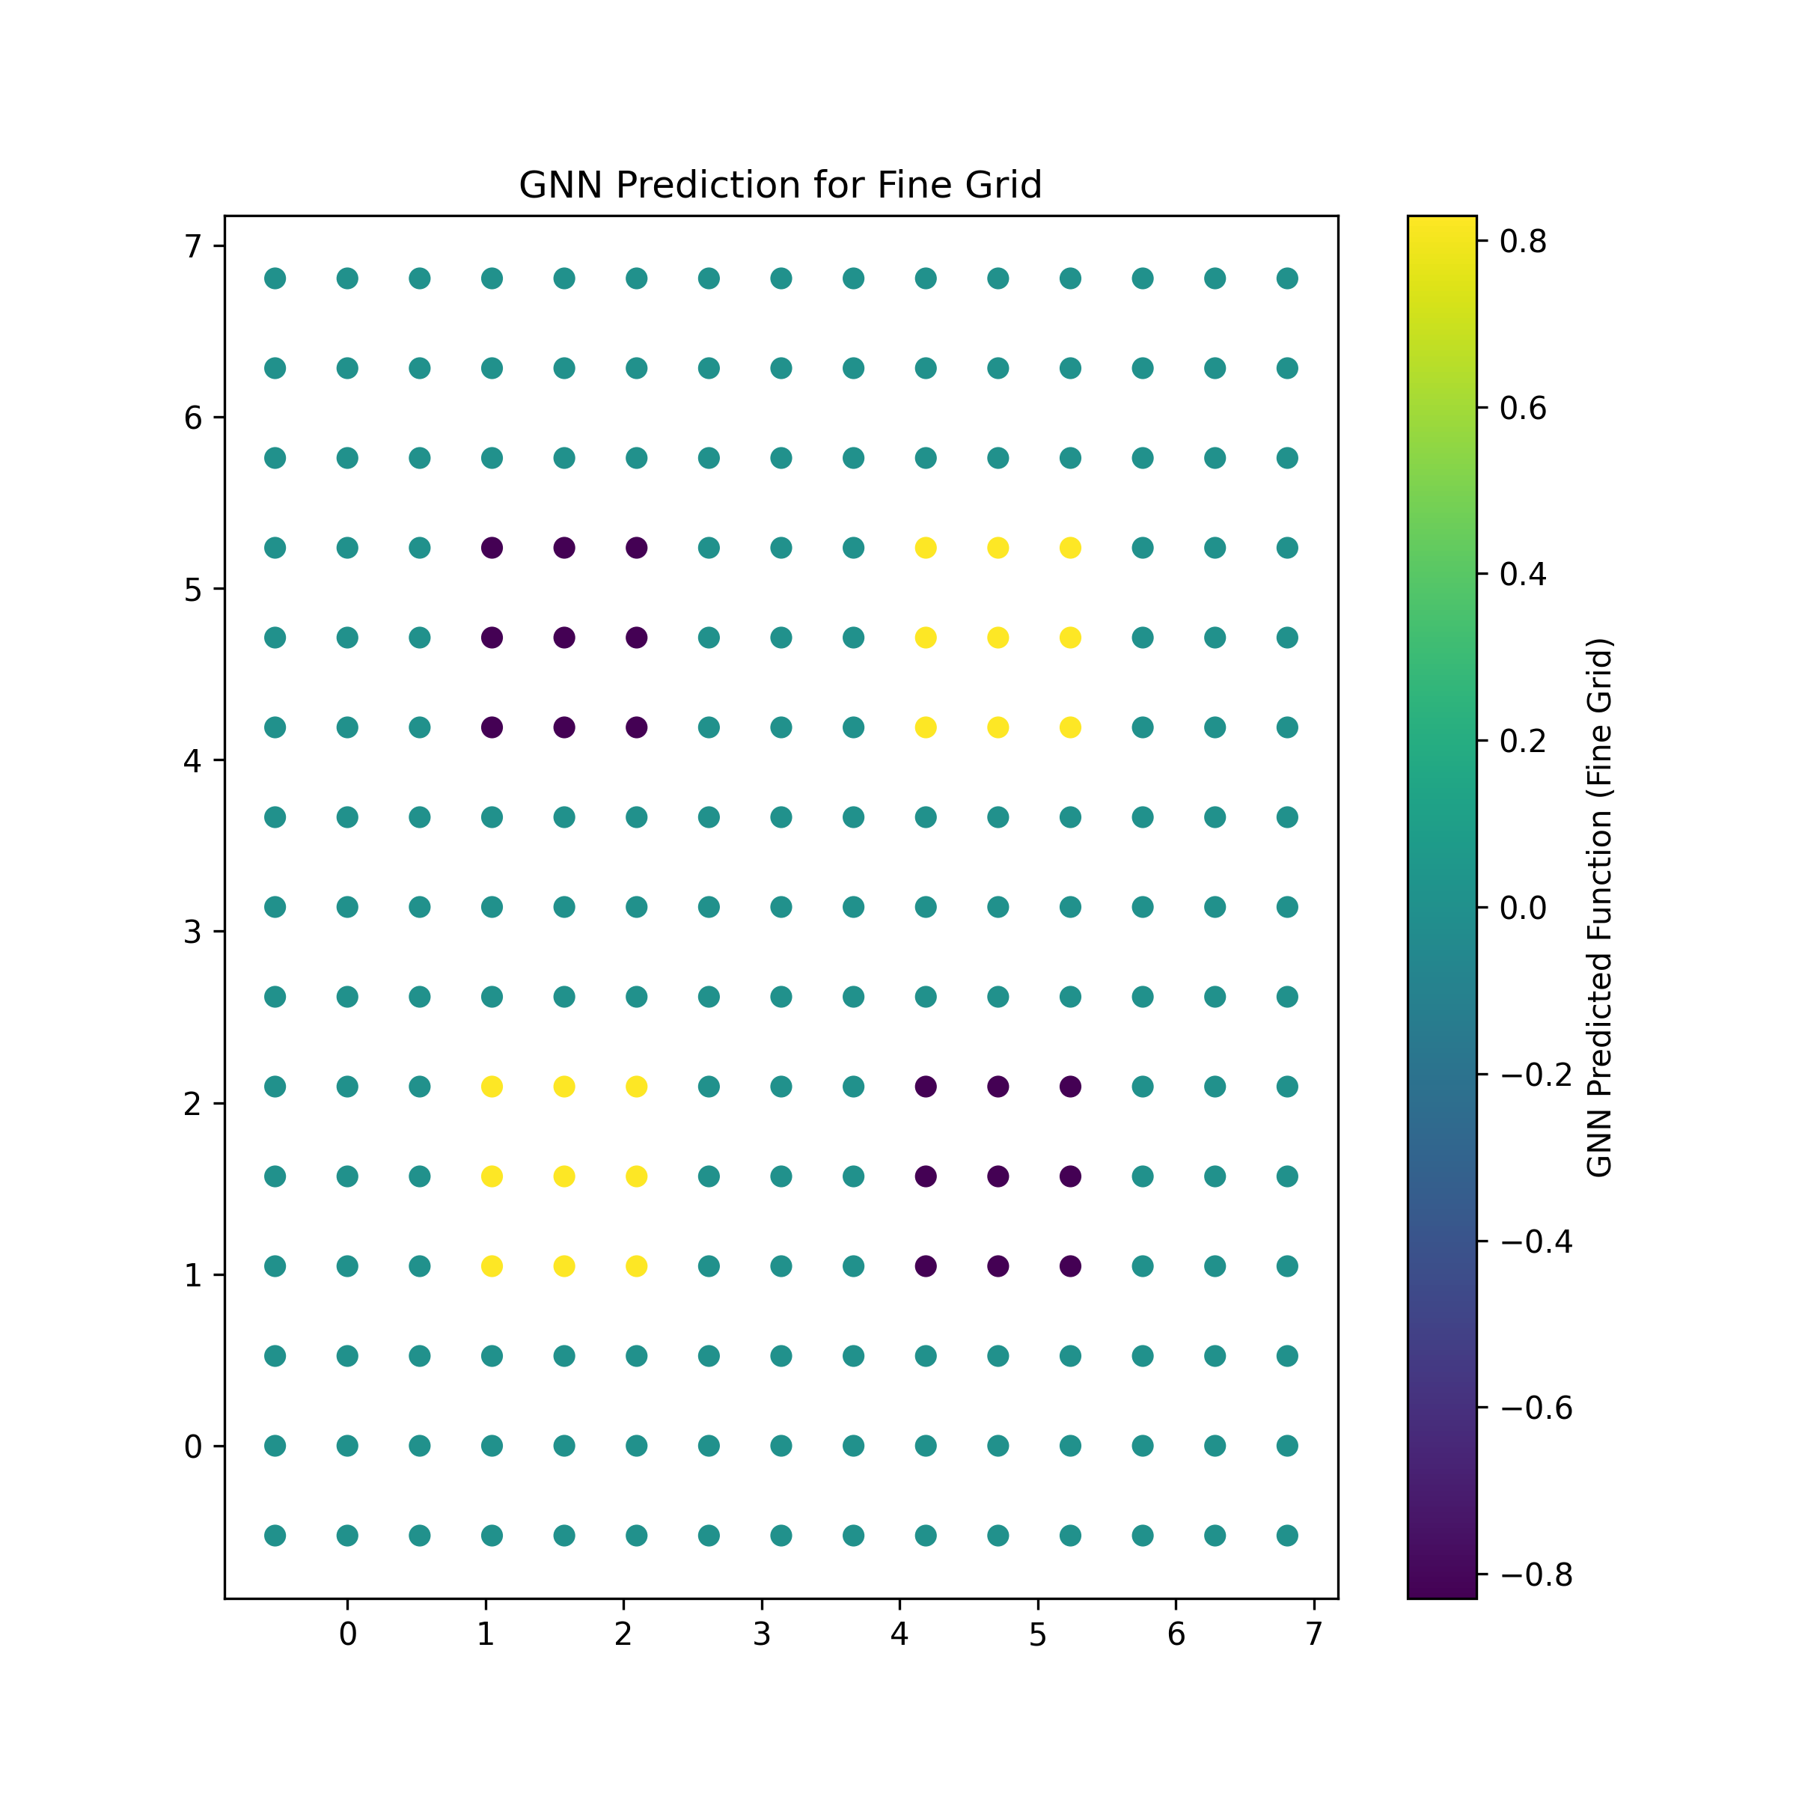
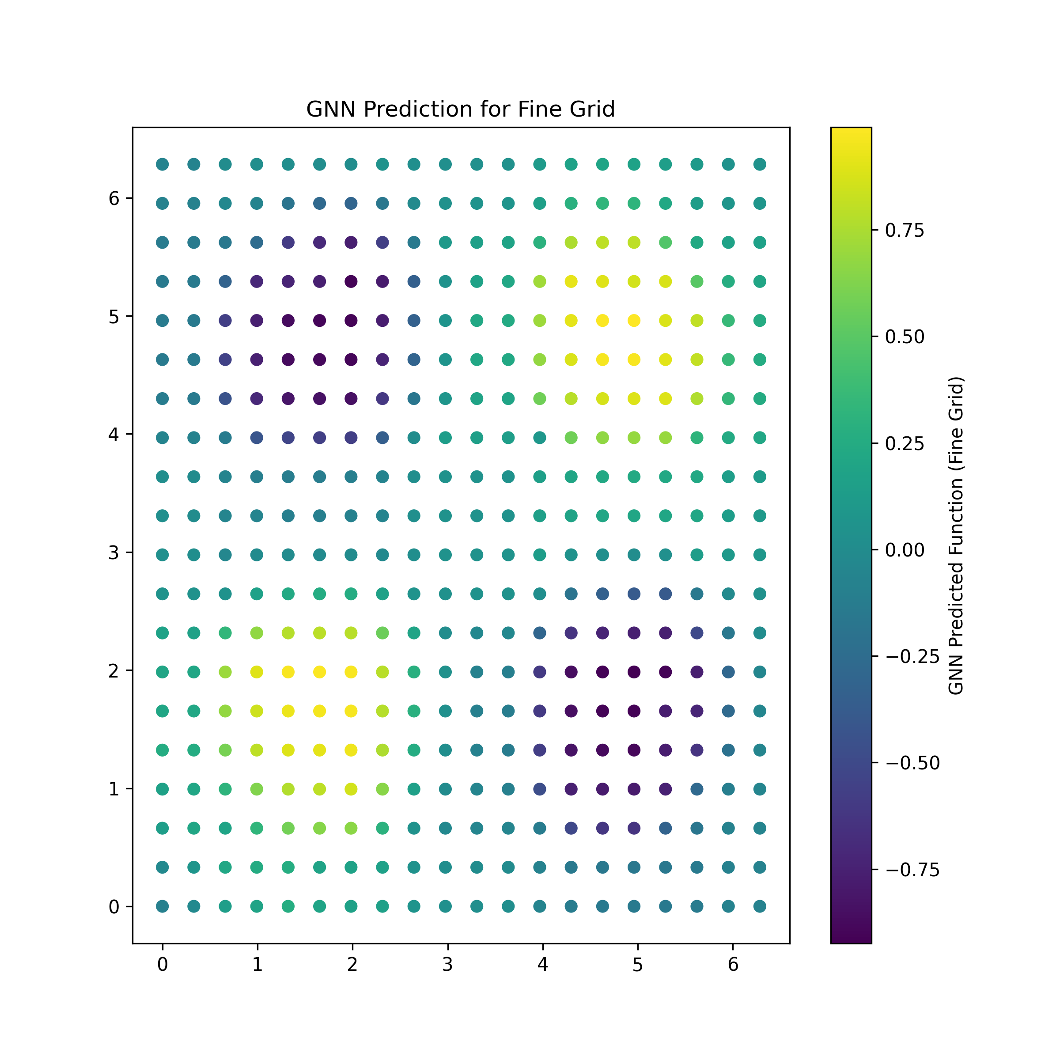
Recommendations Basics 2/3
1.1 Basic Ideas of AI Techniques
Work on Projects:
To implement neural networks for real-world tasks first break it down to generic examples.
Pilot Projects provide a deeper understanding of how to apply neural networks to solve problems, which is essential for mastering the subject.
Explore Advanced Architectures:
Once comfortable with the basics, study advanced models like Graph Neural Networks (GNNs) for working with graph-structured data and Transformers for handling sequential data and tasks such as language translation and text generation.

Slide 14
Recommendations Basics 3/3
1.1 Basic Ideas of AI Techniques
Frameworks
In machine learning and artificial intelligence, frameworks such as
TensorFlow,
PyTorch, and
Scikit-learn
provide essential tools for building, training, and deploying neural networks.
These frameworks streamline tasks like defining models, handling data, and running optimization algorithms, making the development process more efficient and accessible to researchers and developers.
Tools for machine learning extend beyond just building models; they also include platforms for
managing data (e.g., Pandas or Xarray),
visualization (e.g., Matplotlib, Cartopy), and
hyperparameter tuning (e.g., Mlflow Tracking, Optuna, Hyperopt).
These tools help improve the accuracy and efficiency of model training and evaluation.
Environment
In a production environment, MLOps (Machine Learning Operations) is crucial for integrating machine learning into broader software and business workflows.
MLOps tools like Kubernetes, MLflow, and Kubeflow help manage the entire lifecycle of machine learning models, from development to deployment and monitoring.
They ensure that models can be scaled, updated, and maintained efficiently while tracking performance and preventing issues like model drift.

Slide 15
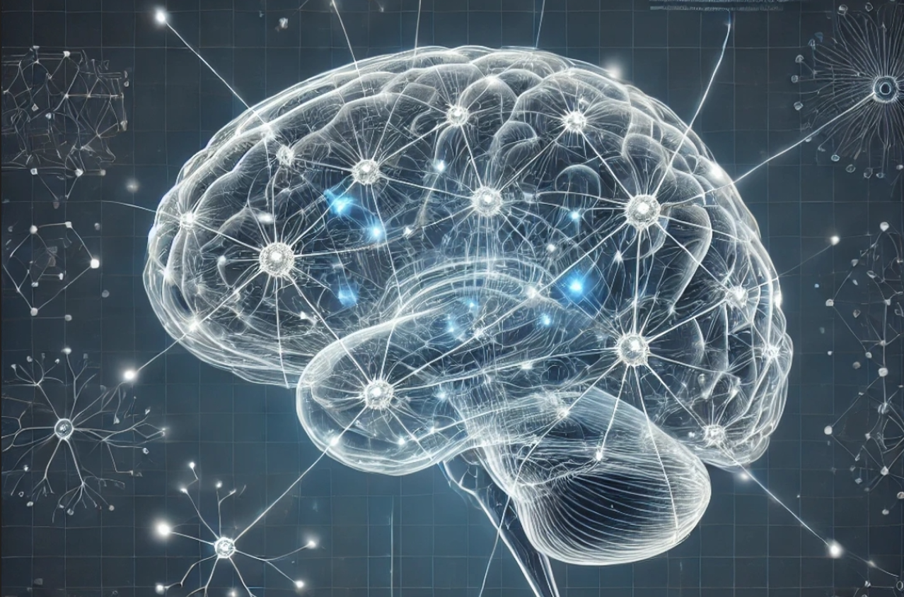
E-AI Basic Tutorials
Tutorial E-AI Basics 1: September 16, 2024, 11-12 CEST
Intro, Environment, First Example
1.1 Basic Ideas of AI Techniques (20') [SH]
1.2 Work Environment (20') [RP]
1.3 First Example for AI - hands-on (20') [JK]
Tutorial E-AI Basics 2: September 18, 2024, 13-14 CEST
Dynamics, Downscaling, Data Assimilation Examples
2.1 Dynamic Prediction by a Graph NN (20') [RP]
2.2 Downscaling via Encoder-Decoder (20') [SH]
2.3 AI for Data Assimilation (20') [JK]
Tutorial E-AI Basics 3: September 23, 2024, 11-12 CEST
LLM Use, Transformer Example, RAG
3.1 Intro to LLM Use and APIs (20') [RP]
3.2 Transformer for Language and Images (20') [JK]
3.3 LLM Retrieval Augmented Generation (RAG) (20') [SH]
1.2

Slide 16
Portable AI Work Environment
1.2 Work Environment
Windows Computer
GPU Nodes
EWC
Linux Workstation
HPC Cluster
GPU Computer
Virtual Server (Cloud)
Google Colab
Recommendation: Carry out portable design, do not limit yourself to one working environment only!

Slide 17
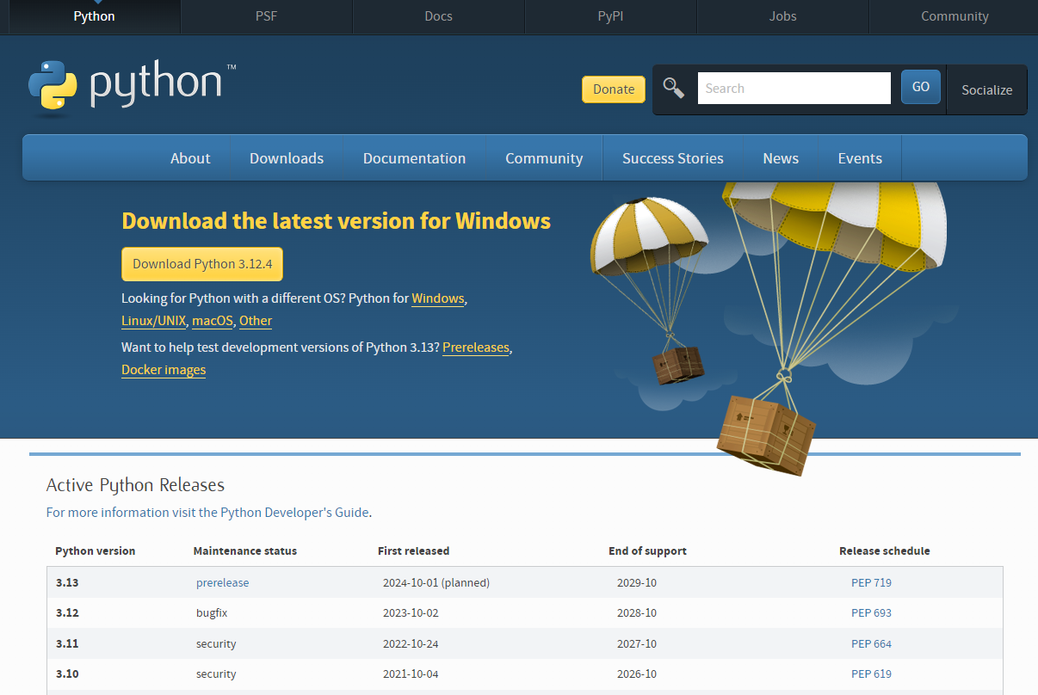
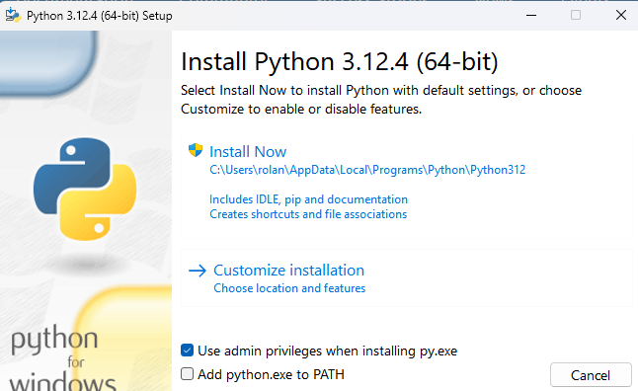
Python for Windows
1.2 Work Environment
Download Python from https://www.python.org/downloads/
Install Python, Klick Add to PATH!!

Slide 18
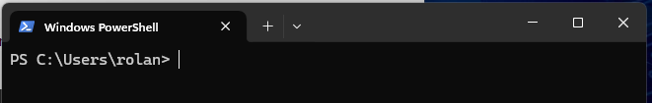
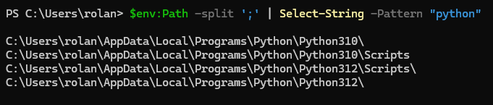
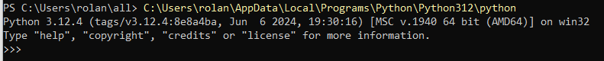
Windows Powershell
1.2 Work Environment
Open Windows Powershell
To check if you installed a python version you might use
> $env:Path -split ';' | Select-String -Pattern "python"
You can now already use python, by calling python in the form, leave by typing exit()

Slide 19
Virtual Environments: Fast Installation
1.2 Work Environment
We recommend to work in a virtual environment
This is the same on Windows, Linux, locally or on a virtual server in the cloud.
A Virtual Environment will be installed in a particular folder, e.g. ropy. This folder should be in a useful place, it does not need to be in your home directory!
You install a virtual python environment based on a particular python version (please use python versions higher than 3.8 at least!!!) by the command:
PS C:\Users\rolan\all> C:\Users\rolan\AppData\Local\Programs\Python\Python312\python -m venv ropy312
This will use python 3.12 and install it into the folder all\ropy312

Slide 20
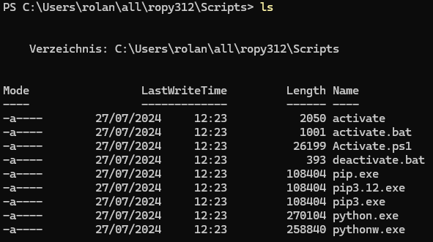
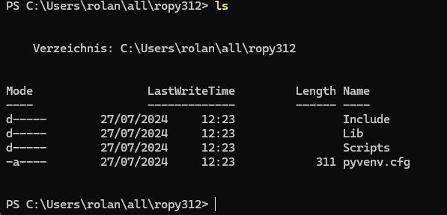
Virtual Environments: Check
1.2 Work Environment
The virtual environment is now located in this folder:
Check the python version by calling .\python –V in the Scripts/ or bin/ folder:
In the Scripts/ folder – which might be called bin/ under Linux, there is a programme called activate. When you call it from anywhere, it will activate this environment in the folder where you have called it.

Slide 21
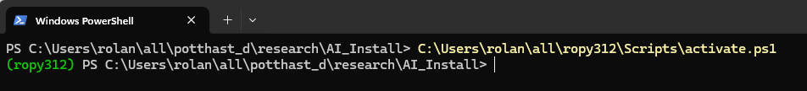
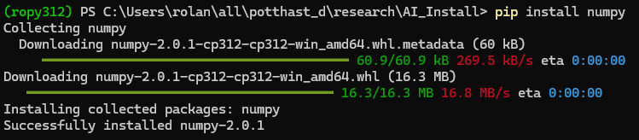
Virtual Environments: Activation
1.2 Work Environment
You activate the virtual environment in a folder by calling it. Under PowerShell you need to call the activate.ps1 version, under Linux or with relative path you can call just activate
You are now in a framework where you can install all packages you need based on the standard “pip” package installer of python. Start by installing “numpy”, the basic numerical package of python.

Slide 22
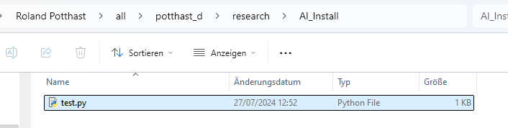
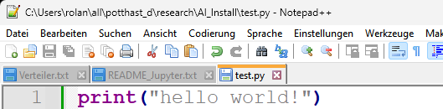
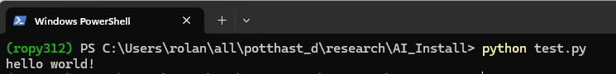
Virtual Environment: Creating and Running Python Programmes
1.2 Work Environment
You can now create a text file “test.py” under windows or linux in the current directory where you are and where you activated your virtual environment.
Edit it with your favourite editor and write print(“hello world!”) into the file.
Execute the python programme by calling > python test.py under your virtual environment.

Slide 23
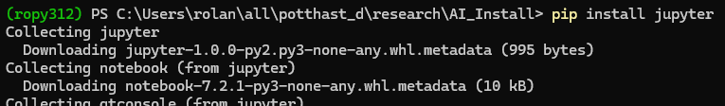
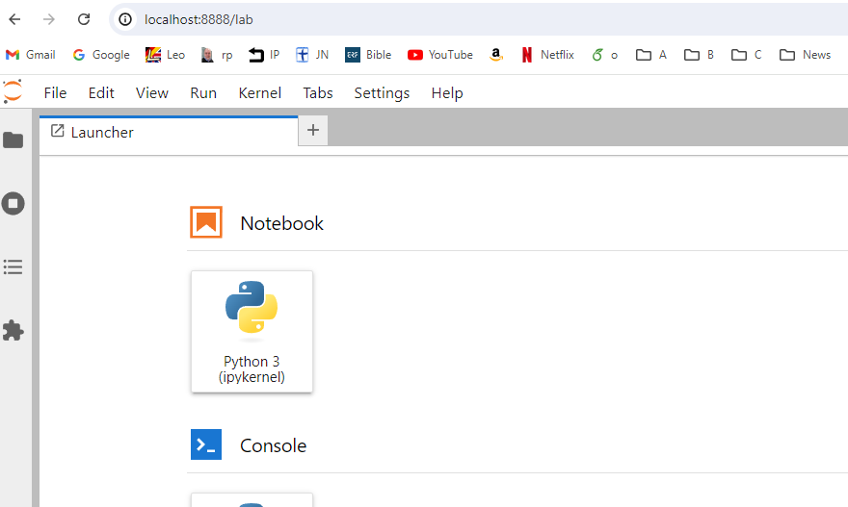
Jupyter Notebooks and Jupyter Lab
1.2 Work Environment
We start by installing the package Jupyter, which is a very popular and common web-interface to your python framework. Type
> pip install jupyter
Then lauch jupyter lab by typing
> jupyter lab
within your virtual environment.
It will open a browser window based on a local webserver which will be an user interface with your virtual python environment.

Slide 24
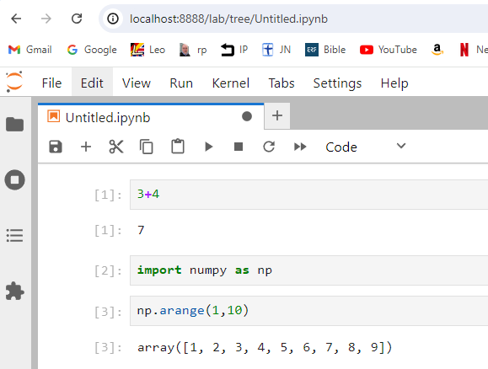
Virtual Environment: Using a Jupyter Notebook
1.2 Work Environment
You can use python interactively typing into the cells.
Packages are loaded and addressed by import … as …, for example the numpy package by > import numpy as np, a typical standard command.
Cells are executed by shift-enter, when your curser is placed there.
You can now develop applications in python, usually you will consoult either consult online tutorials, websites or your preferred AI assistant.

Slide 25
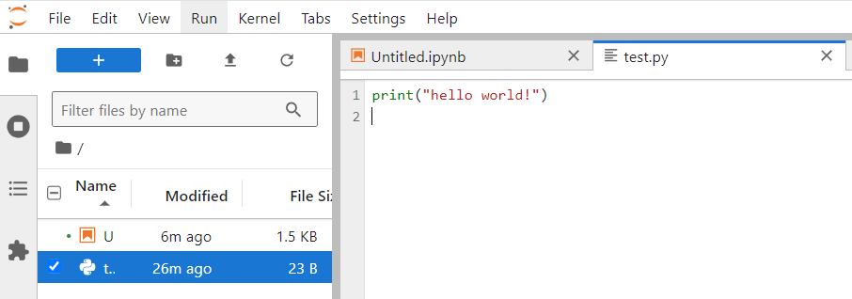
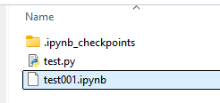
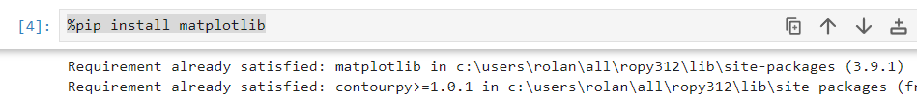
Virtual Environment: Jupyter Lab
1.2 Work Environment
Jupyter Lab also provides an Editor for your python codes
Jupyter notebooks are saves as .ipynb files.
Here, you can choose the pull-down menu to save the notebook as test001.ipynb
Go back to your virtual environment and install the plotting library matplotlib by typing
> pip install matplotlib
In your jupyter notebook you can carry out such commands by typing
%pip install matplotlib
into a cell and executing that cell.

Slide 26
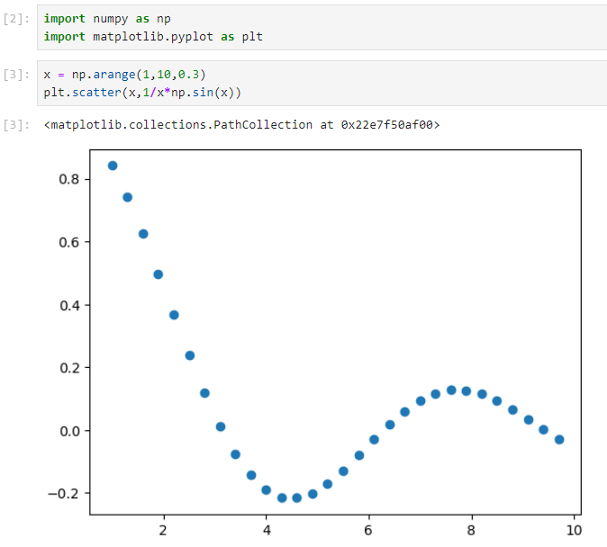
Virtual Environment: Creating Visualizations
1.2 Work Environment
Before going to AI applications, you need to be literate in standard python applications.
Visualization based on matplotlib, e.g. the scatter() library function, and further plots, will be the basis for developing, checking and testing AI applications.
There is an extensive amount of material on the Web and provided by AI assistants!

Slide 27
Python on Linux
1.2 Work Environment
On linux, you approach might depend on your rights. Let us assume that you are a normal user and that there is python3.10 installed. Then, you can test this by typing > python –V
You install your virtual environment the same way as described above.
In your virtual environment you can install your packages.
numpy
matplotlib
jupyter
cartopy
eccodes
netcdf4
scikit-learn
torch
pyyaml
Tensorflow
keras

Slide 28
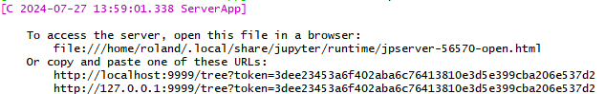
Jupyter on a remote Linux computer accessed with Windows Browser
1.2 Work Environment
You can run your python environment on some remote Linux computer, but still carry out all interaction with your local Windows browser.
To this end install some shell on windows, for example the git shell, which has all you need: https://git-scm.com/download/win
Make sure you can login to the remote Linux computer, for example using its IP address, e.g. 192.168.178.79. You can find this address by typing ifconfig (Linux) or ipconfig (Windows) on the computer.
To this end you start your jupyter notebook on the Linux computer without browser on some port by > jupyter notebook --no-browser --port=9999 &
The output will also give you a token necessary to establish the connection.
Then setup a connection from a local shell on the Windows computer by port forwarding
> ssh -N -f -L localhost:9997:localhost:9999 roland@192.178.168.79
And in your Windows browser use the local port 9997 and the token:
http://localhost:9997/tree?token=3dee23453a6f402aba6c76413810e3d5e399cba206e537d2

Slide 29
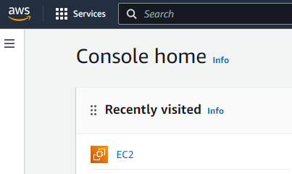
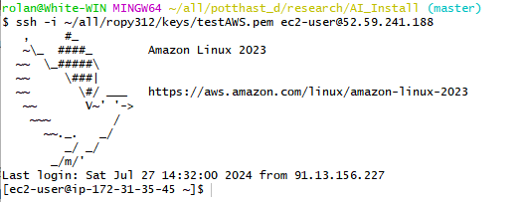
Python on a Virtual Server in the Cloud
1.2 Work Environment
Here we describe how to setup your python environment on an AWS EC2 Linux Server.
You need an AWS account. Then create an instance of a server.
It will create or use a .pem key for you to access the server. Download it, store e.g. in ~/all/ropy312/keys/testAWS.pem.
AWS will also tell you the public ip of the server, e.g. 52.59.241.188
Then you can access the server by
> ssh -i ~/all/ropy312/keys/testAWS.pem ec2-user@52.59.241.188
Now, you can carry out all steps as for the above windows or linux servers, i.e. python3 –V
You can setup python, torch and access your environment by jupyter lab through port forwarding.

Slide 30
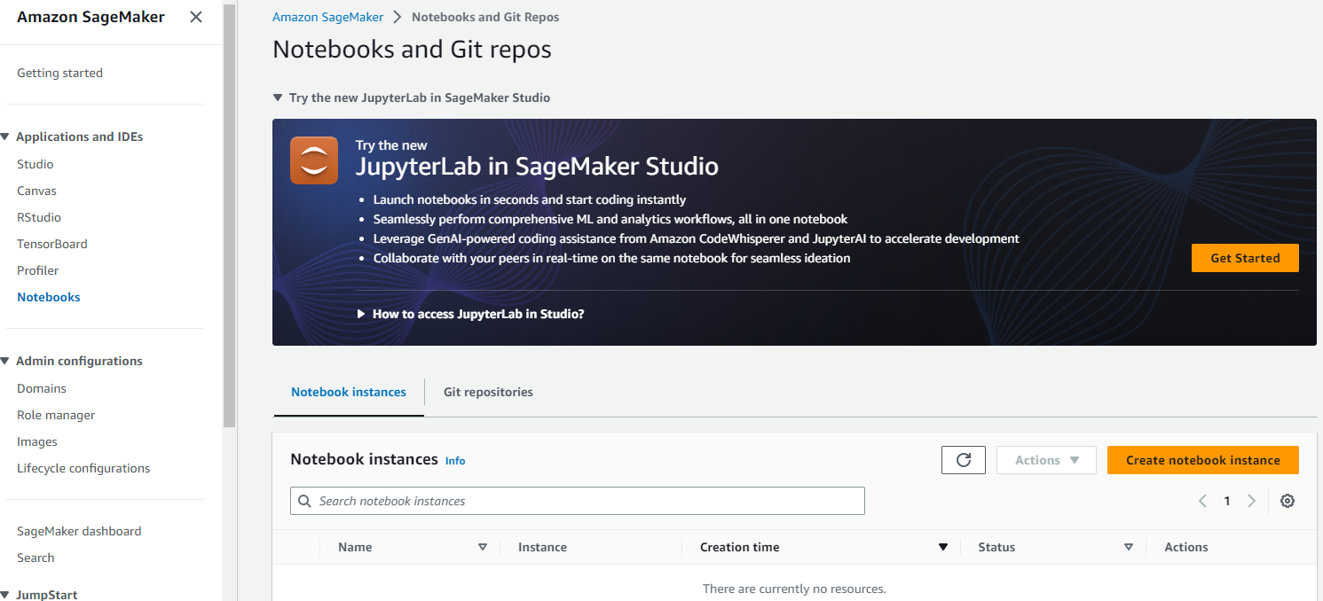
Python AI by AI Ready Tools in the Cloud
1.2 Work Environment
AWS provides specialized AI enabled packages, where you can directly access jupyter lab or jupyter notebooks with installed torch packages
AI Ready Jupyter Notebook in 3 Klicks

Slide 31
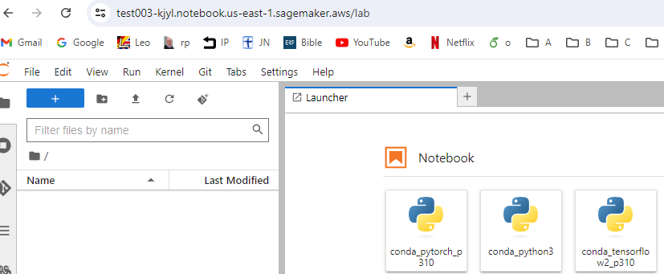
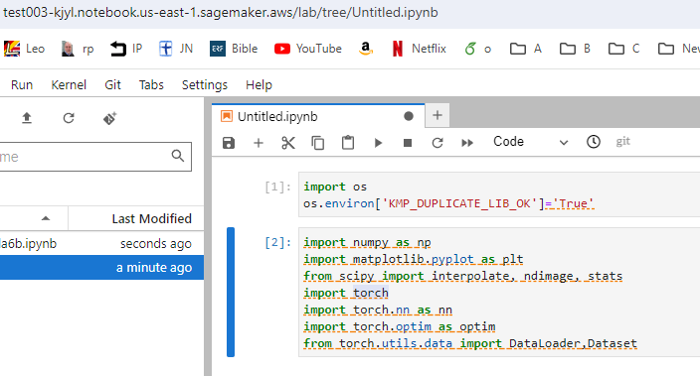
Jupyter Notebook AI Ready
1.2 Work Environment
The Toolkit has all necessary tools for AI development preinstalled and ready to use.
Complex AI Applications e.g. based on PyTorch can be copied over and run immediately.

Slide 32
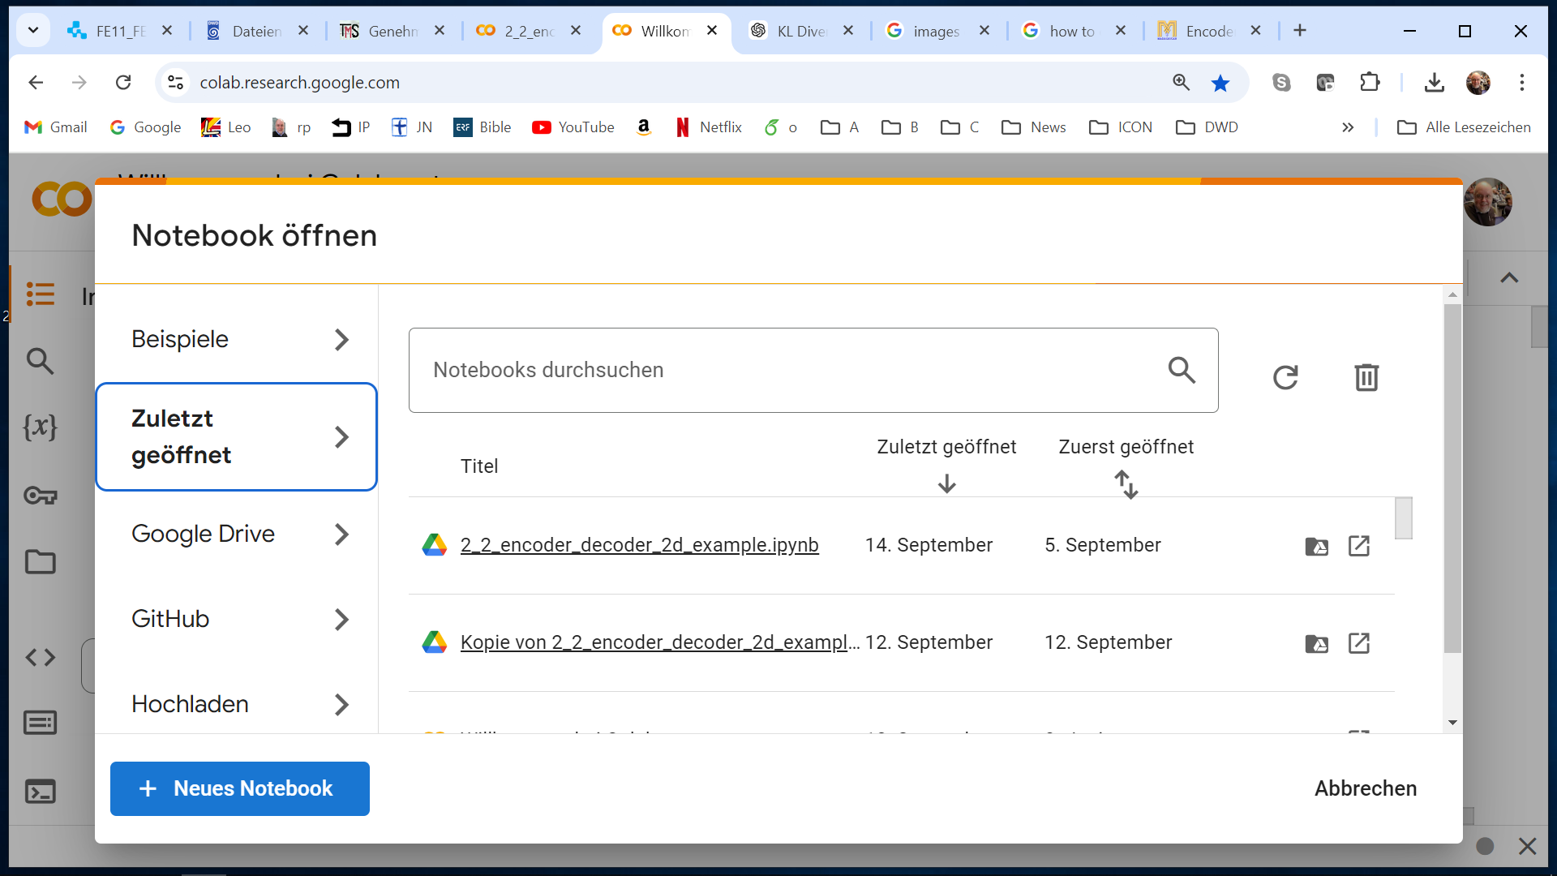
Using Google Colab enables AI programming, integrated with Gemini
Ready to go AI environment

Slide 33
E-AI Basic Tutorials
Tutorial E-AI Basics 1: September 16, 2024, 11-12 CEST
Intro, Environment, First Example
1.1 Basic Ideas of AI Techniques (20') [SH]
1.2 Work Environment (20') [RP]
1.3 First Example for AI - hands-on (20') [JK]
Tutorial E-AI Basics 2: September 18, 2024, 13-14 CEST
Dynamics, Downscaling, Data Assimilation Examples
2.1 Dynamic Prediction by a Graph NN (20') [RP]
2.2 Downscaling via Encoder-Decoder (20') [SH]
2.3 AI for Data Assimilation (20') [JK]
Tutorial E-AI Basics 3: September 23, 2024, 11-12 CEST
LLM Use, Transformer Example, RAG
3.1 Intro to LLM Use and APIs (20') [RP]
3.2 Transformer for Language and Images (20') [JK]
3.3 LLM Retrieval Augmented Generation (RAG) (20') [SH]
1.3

Slide 34

Simple PyTorch example
1.3 First Example for AI - hands-on
A Simple AI Example which runs on all these platforms
Loading necessary packages
Preparing the data
Setting up the neural network architecture
Running the training loop
Looking at the results

Slide 35


Data
1.3 First Example for AI - hands-on
Example: we try to learn the calculation of wind chill
Prepare the data:

Slide 36


Neural Network Architecture
1.3 First Example for AI - hands-on
Set up the architecture
Initialize the model

Slide 37


Training loop
1.3 First Example for AI - hands-on
epoch == full data set iteration

Slide 38


Look at the results
1.3 First Example for AI - hands-on
“loss curve”

Slide 39



Look at the results
1.3 First Example for AI - hands-on
Validation data set

Slide 40


Tune the model
1.3 First Example for AI - hands-on
Changing architecture and learning rate

Slide 41


Tune the model
1.3 First Example for AI - hands-on

Slide 42


Tune the model
1.3 First Example for AI - hands-on
“loss curve”

Slide 43


Tune the model
1.3 First Example for AI - hands-on
Validation results

Slide 44

AI on GPU Nodes
1.3 First Example for AI - hands-on
You need to adapt your code to send torch tensors to the gpu, see example
Send tensors back to cpu to generate plots

Slide 45
E-AI Basic Tutorials
Tutorial E-AI Basics 1: September 16, 2024, 11-12 CEST
Intro, Environment, First Example
1.1 Basic Ideas of AI Techniques (20') [SH]
1.2 Work Environment (20') [RP]
1.3 First Example for AI - hands-on (20') [JK]
Tutorial E-AI Basics 2: September 18, 2024, 13-14 CEST
Dynamics, Downscaling, Data Assimilation Examples
2.1 Dynamic Prediction by a Graph NN (20') [RP]
2.2 Downscaling via Encoder-Decoder (20') [SH]
2.3 AI for Data Assimilation (20') [JK]
Tutorial E-AI Basics 3: September 23, 2024, 11-12 CEST
LLM Use, Transformer Example, RAG
3.1 Intro to LLM Use and APIs (20') [RP]
3.2 Transformer for Language and Images (20') [JK]
3.3 LLM Retrieval Augmented Generation (RAG) (20') [SH]
Thank You!

Slide 46

AI on GPU Nodes
1.3 First Example for AI - hands-on
Log into your GPU node, e.g. ssh rpotthas@gpnl102
Load you python modules, e.g. by module load python/3.10.11
Setup your virtual environment
You might need additional setup commands to run Jupyter lab on your GPU node, ask your local administrator
To control the GPU to run your notebook on, there is the command
> CUDA_VISIBLE_DEVICES=5 python test.py
Show the use of GPUs currently:
> nvidia-smi

